Slide 1
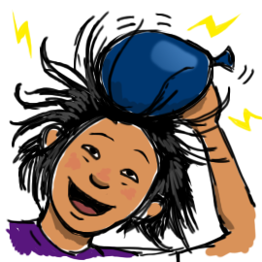
Static Electricity!

Slide 2
Electricity (?)
All phenomena caused by positive and negative charges
Static Electricity (?)
All the phenomena related to electrical charges at rest

Slide 3
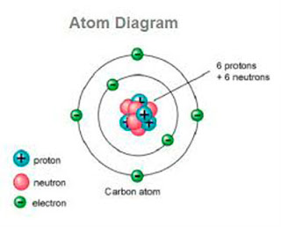
Positive and negative charges
ONLY ELECTRONS MOVE

Slide 4
Static Charge
Charging
By Friction
By Conduction
By Induction
CHARGING: creating an imbalance of charges in an object

Slide 5
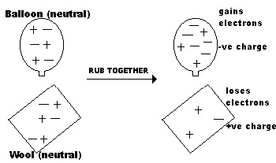
Static Charge - FRICTION
FRICTION: pulls electron away from one of the objects and transfers them to the other

Slide 6
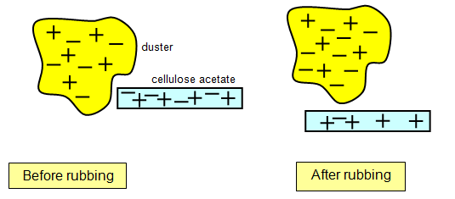
Which one gets the electrons?
Triboelectric Series
a.k.a. electrostatic series
List of materials from
ones that tend to lose e- (become positive)to
ones that tend to gain e- (become negative)
+ Acetate
Hair
Wool
- Rubber

Slide 7
Example (Wool and Rubber)
List of materials from
ones that tend to lose e- (become positive)to
ones that tend to gain e- (become negative)
***Note: Sometimes, the list is the other way around. Read the legend!
+ Acetate
Hair
Wool
- Rubber
Rubbing

Slide 8
Opposites Attract
(Like Charges Repel)
Attraction (+/-)
Repulsion (+/+, -/-)

Slide 9
What do I do?
A
B
C
C
D
A
A

Slide 10
*Important*
Only ELECTRONS move
How to read the Triboelectric series
Opposites attract/Like charges repel

Slide 11
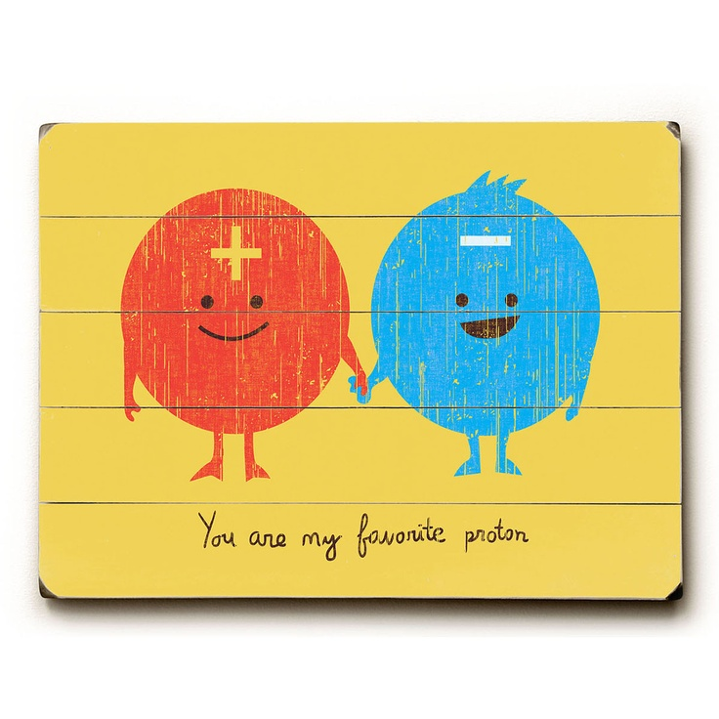

Slide 12
A few definitions
Conductor: allows free flow of electrical charges
Insulator: hinders free flow of electrical charges

Slide 13
Static Charge - CONDUCTION
Charging by CONDUCTION: The charge of one object is shared between two objects when they come into contact.

Slide 14
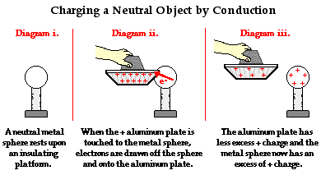
Charging by CONDUCTION

Slide 15
Static Charge - INDUCTION
INDUCTION: The proximity (no contact) of the charged object causes the charges in the neutral object to separate

Slide 16
Static Charge - INDUCTION

Slide 17
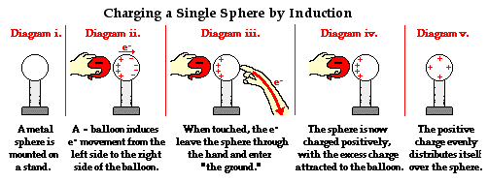
Charging by INDUCTION

Slide 18
Charging by INDUCTION

Slide 19
Summary Table
Charging By | BEFORE | DURING | AFTER
FRICTION |  | Rubbing transfers electrons from one object to the other
CONDUCTION |  | Direct transfer of charge
INDUCTION |  | Proximity of a charged object causes a separation of charges in the neutral object.

