Slide 1
Dynamic Electricity
Electrical Circuits

Slide 2
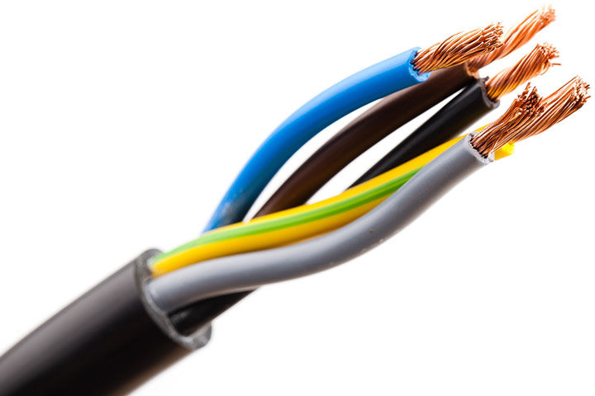
Dynamic Electricity
All phenomena related to electrical charges in motion. (i.e. flow of charges in a circuit)
What is needed?
Power supply (battery, outlet)
Conductor of electric current
Use for the electricity
light bulb, display, heater, etc.

Slide 3
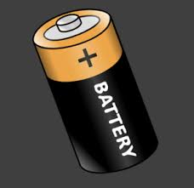
Power Supply
Battery
+
+
+
+
+
_
_
_
_
_

Slide 4
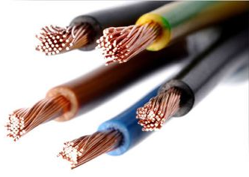
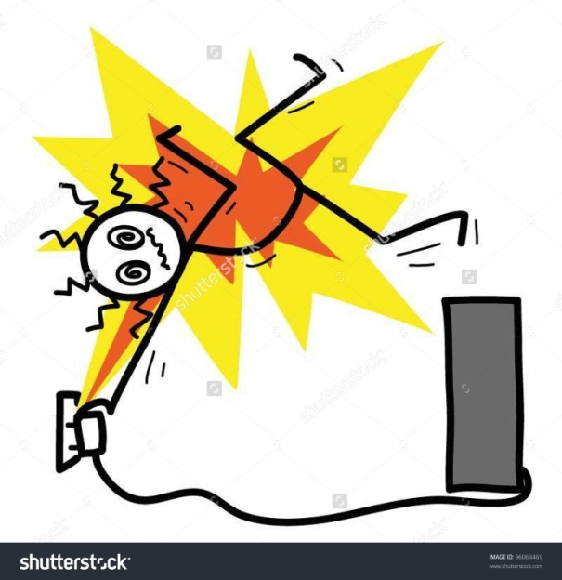
Conductors and Insulators
Conductor: any component that can transmit an electric current
E.g. ???
Insulator: any component that prevents an electric current from flowing
E.g. ???

Slide 5
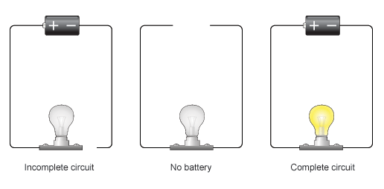
Circuits
Open
No battery
Closed

Slide 6
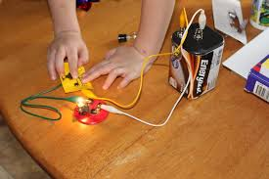
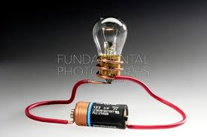
Circuit

Slide 7
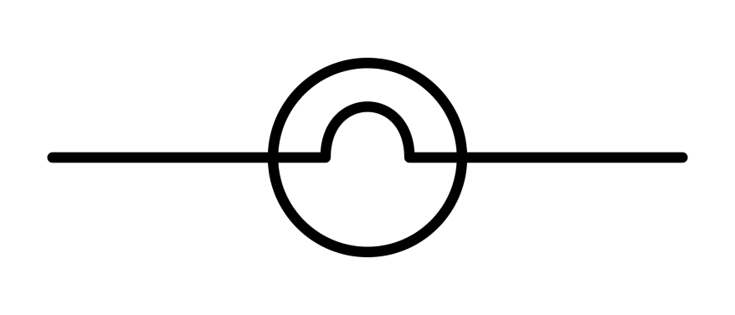
BASIC Components and symbols
electrical wire

Slide 8
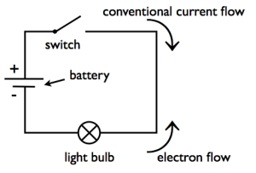
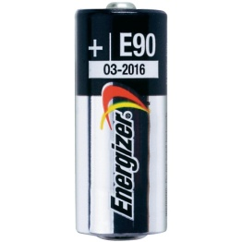
Circuit Diagrams

