Slide 1
Mechanical Engineering
Motion Systems

Slide 2
Motion Systems Overview
Types of Motion Systems
Motion Transmission Systems
Speed Change
Motion Transformation Systems

Slide 3
Types of Motion Systems

Slide 4
Motion Transmission System?
Def: Relaying the same type of motion from one part of the system to the other part.
  Translational motion at the beginning to translational motion at the end
  Rotational motion at the beginning to rotational motion at the end

Slide 5
Motion Transformation Systems?
Definition: Relaying a motion from one part of the system to another, while changing its form
Translational motion to Rotational motion
Rotational motion to Translational motion

Slide 6
Motion systems contain
Most basic
Driver component which begins the motion
Driven component which receives the motion
More complex systems also have
Intermediate components which are in-between the driver and driven component to transfer the motion from the driver to the driven.

Slide 7
Motion Transmission Systems

Slide 8
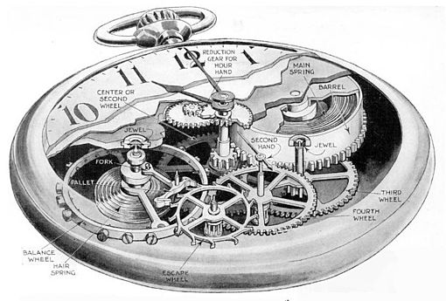
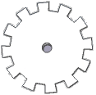

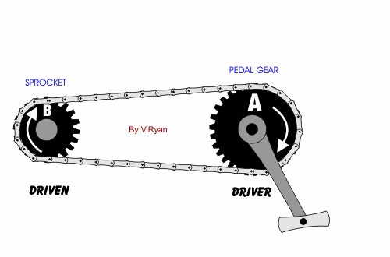
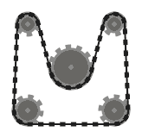
Gear Train
Series of interlocking gears
Chain and Sprocket
Sprockets (gears) surrounded by a chain

Slide 9
Gear Trains
Contains at least two gears that mesh together
Direction of components | Alternates from one gear to another
Is it reversible | Yes

Slide 10
Gear Trains
When building a gear train, there are three factors that need to be considered
The teeth size must be constant
If the gear is spur (parallel) or beveled (perpendicular)
The gear size
  More teeth = larger diameter = slower rotation
  Less teeth = smaller diameter = faster rotation

Slide 11
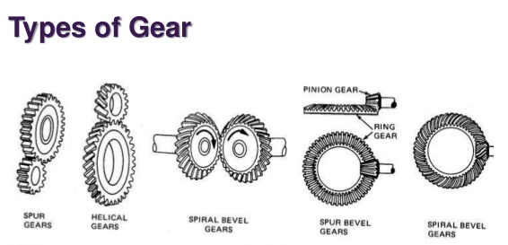
Spur Gear vs Bevel Gear

Slide 12
Gear Train
Series of interlocking gears
Chain and Sprocket
Sprockets (gears) surrounded by a chain

Slide 13
Chain and Sprocket
Connects components that are far away from each other
The gears (sprockets) do not mesh together, but are connected with a chain
Direction of components | Sprockets touching the same side of the chain turn in the same direction
Is it reversible | Yes

Slide 14
Chain and Sprocket
When building a chain and sprocket, there are three factors that need to be considered
The teeth on the sprocket are identical to those on the chain, and must mesh easily
The system requires constant lubrication
The smaller the sprocket = the faster it turns

Slide 15
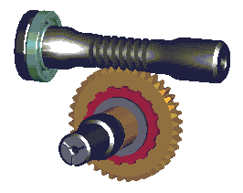
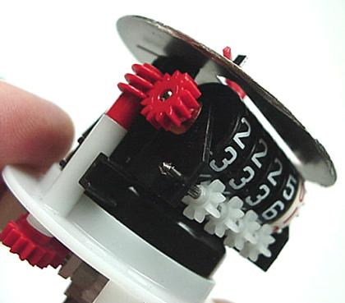
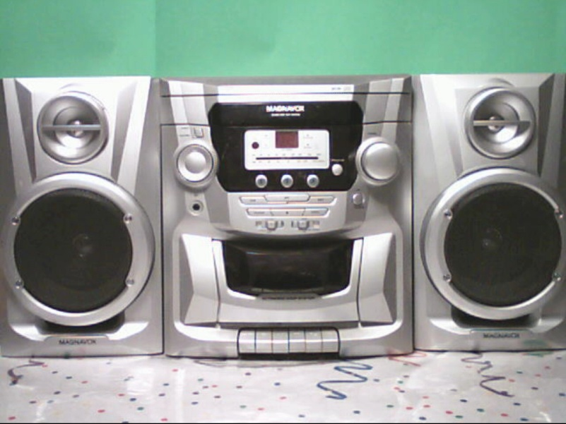
Worm and Worm Gear
Worm (screw) which turns a worm gear
Friction Gear System
Like a gear train, but without teeth

Slide 16
Worm and Worm Gear
Consists of one endless screw and at least a gear
Direction of components | Depends on the threading of worm screw shaft
Is it reversible | NO (only system not reversible)

Slide 17
Worm and Worm Gear
When building a worm and worm gear, there are two factors that need to be considered
The gear teeth match the worm’s grooves
The driver must be the worm

Slide 18
Worm and Worm Gear
Worm (screw) which turns a worm gear
Friction Gear System
Like a gear train, but without teeth

Slide 19
Friction Gear System
Like Gear Trains, but less efficient (slips)
Direction of components | Alternates from one gear to another
Is it reversible | Yes

Slide 20
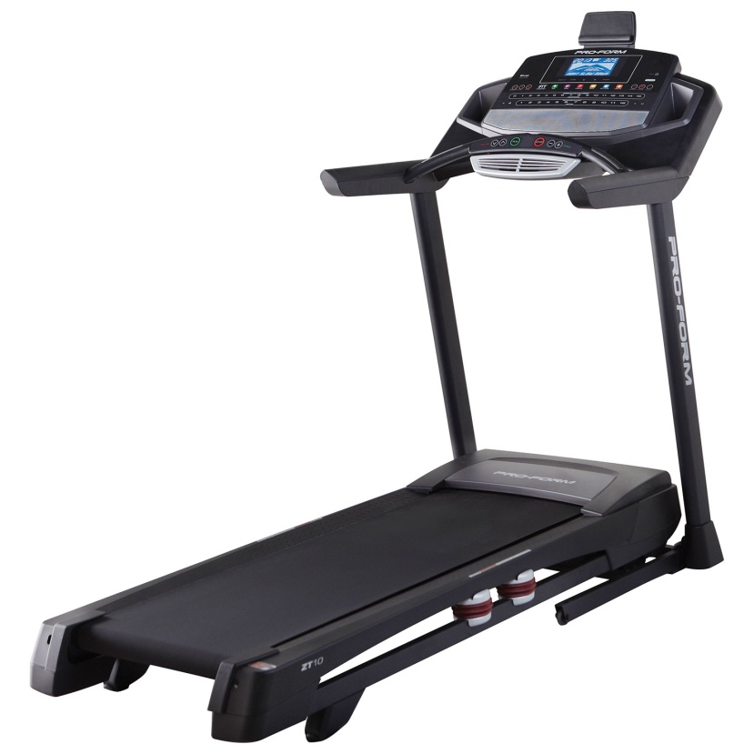
Belt and Pulley System
Like a Chain and Sprocket, but without teeth

Slide 21
Belt and Pulley System
Like Chain and Sprocket, but lacks teeth
Direction of components | Pulleys touching the same side of the belt turn in the same direction
Is it reversible | Yes

Slide 22
Belt and Pulley System
When building a belt and pulley system, there are three factors that need to be considered
Pulleys have a grove for the belt to fit
The belt sticks to the pulleys
The smaller the pulley = faster it turns

Slide 23
Speed Changes in Motion Transmission Systems

Slide 24
Speed Changes in Worm Gears
For each turn of the worm, the gear moves by one tooth
The greater the number of teeth, the slower the speed

Slide 25
Speed Changes in the Remaining Systems
The speed varies with the number of teeth/diameter of the gears
If motion is transmitted from a large gear to a small gear, speed increases
If motion is transmitted from a small gear to a large gear, speed decreases
If motion is transmitted to gears of equal size, no speed change occurs

Slide 26
Speed Change Calculation
To find out the exact speed of the driven gear we must find the speed ratio:
Speed ratio = diameter/number of teeth of the driver gear
  diameter/number of teeth of the driven gear

Slide 27
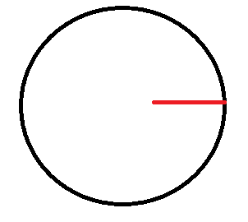
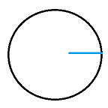
Driven
Motion reaches here
Driver
Motion starts here
Speed is increasing

Slide 28
Driven
Motion reaches here
Driver
Motion starts here
Speed is decreasing

Slide 29
Driven
Motion reaches here
Intermediate
Driver
Motion starts here
Speed is constant

Slide 30
A - 20 cm
B - 10 cm
A - 10 cm
B - 20 cm
A - 20 cm
B - 20 cm
A - 20 cm
B - 10 cm
C- 15 cm
B
C

Slide 31
Situation A
d= 20cm
d= 10cm
Driven
Motion reaches here
Driver
Motion starts here
Speed ratio: driver diameter
driven diameter
Speed ratio: 20cm = 2
10cm

Slide 32
Situation B
d= 20cm
d= 10cm
Driven
Motion reaches here
Driver
Motion starts here
Speed ratio: 10cm = 0.5
20cm

Slide 33
Situation C
d= 20cm
d= 20cm
Driver
Motion starts here
Driven
Motion reaches here
Speed ratio: 20cm = 1
20cm

Slide 34
Situation D
d= 20cm
d= 10cm
d= 15cm
Driven
Motion reaches here
Intermediate
Driver
Motion starts here
Speed ratio: 20cm = 1.33
15 cm

Slide 35
Motion Systems
*Motion Transmission System Types
Motion Transformation System Types
Gear Train
Chain and Sprocket
Worm and Worm Gear
Friction wheels
Belt and Pulley
Speed changes
Speed ratios
*Cam and Follower
*Slider-Crank Mechanism
*Rack and Pinion
Screw Gear (type I)
Screw Gear (type II)

Slide 36
Motion Transformation Systems

Slide 37
Motion Transformation Systems
Definition: Relaying a motion from one part of the system to another, while changing its form
Translational motion to Rotational motion
Rotational motion to Translational motion

Slide 38
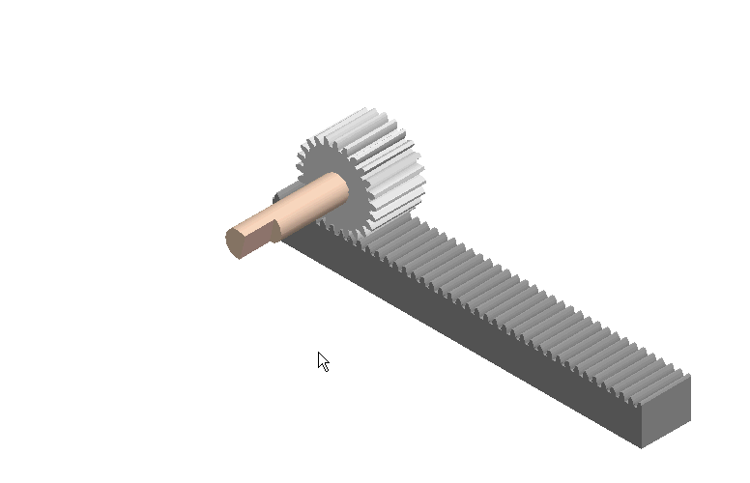
*Rack and Pinion
Rack (bar with teeth)
and Pinion (gear)

Slide 39
Rack and Pinion
Contains a rack (straight bar with teeth) and a pinion (gear).
Rotational → Translational (driver = ________)
Translational → Rotational (driver = ________)
This system is reversible
While building a rack and pinion you must ensure that:
  The teeth on both the rack and pinion must match
  The system requires frequent lubrification
  More teeth on pinion = slower rotation
Pinion
Rack

Slide 40
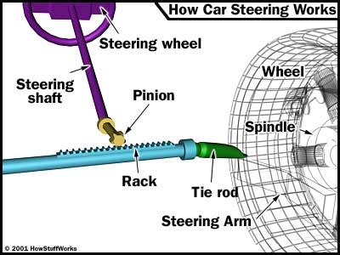
Where do we have Rack and Pinions?

Slide 41
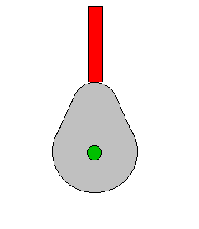
*Cam and Follower
Cam (circular component) and follower (red stick)

Slide 42
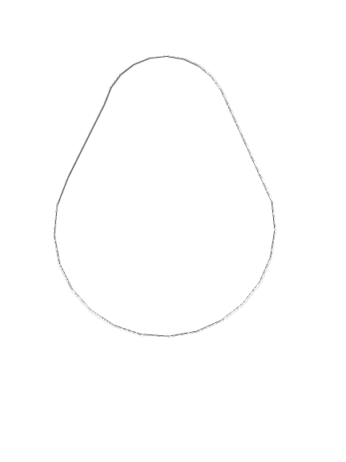
Cam and Follower
Rotational motion to translational motion
Reversible?
No

Slide 43

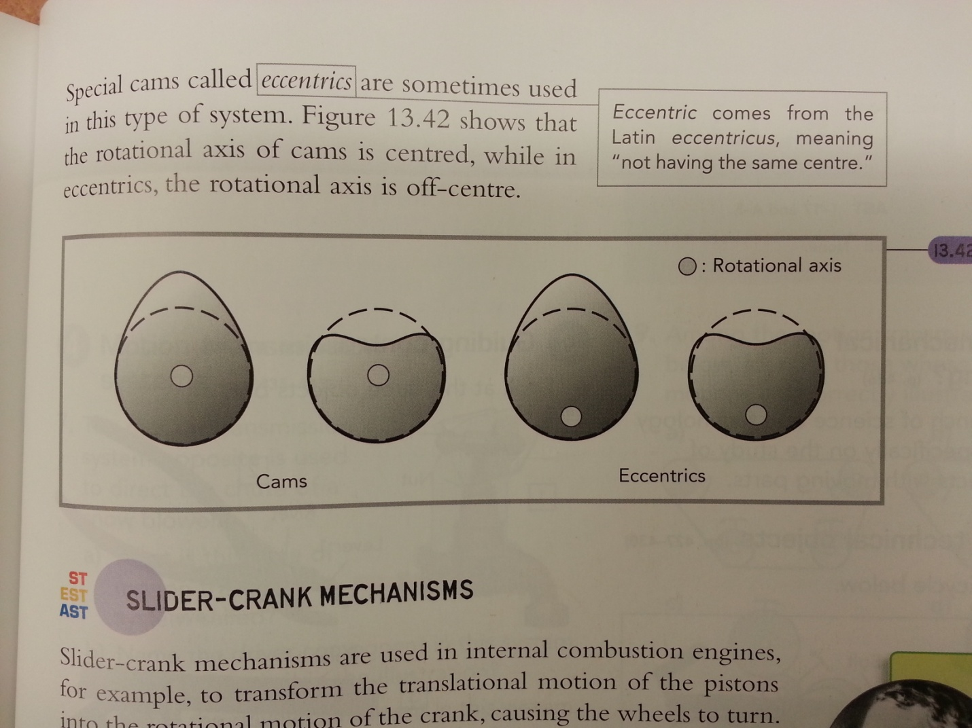
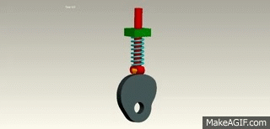
Cam and Follower
When building a cam and follower, you must ensure that:
  The follower must be have a translational guide
  The shape of the cam determines how the follower will move
    An eccentric has the same shape as a cam, but its rotational
    axis is off-center.
  A spring is usually needed to keep the follower in contact with the cam

Slide 44
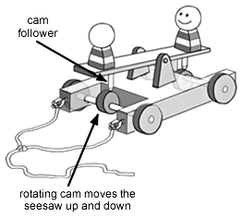
Cam and Follower Uses
Toys

Slide 45
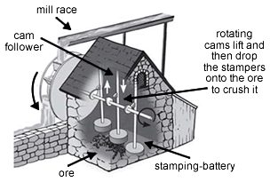
Cam and Follower Uses
Water Powered Mill

Slide 46
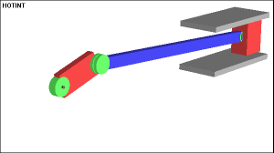
*Slider-Crank Mechanism
Crank (rotational component)
Slider
Connecting rod

Slide 47
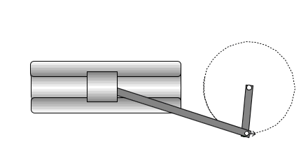
Slider-Crank Mechanism
Crank
Rotational → Translational (driver = __________)
Translational → Rotational (driver = ___________)
Reversible?
This is the mechanisms used in pistons
Slider
Yes

Slide 48
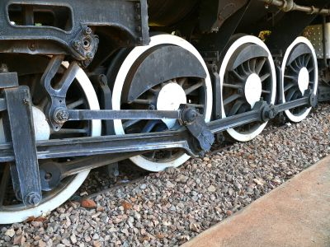
Slider-Crank Uses
Trains-wheels

Slide 49
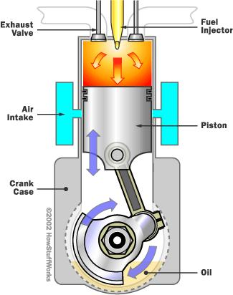
Slider-Crank Uses
Internal Combustion Engines-Cars

Slide 50
Slider-Crank Mechanism
Considerations
The connecting rod attaches the crank to the slider.
The slider must have a translational guide.
The system requires frequent lubrification.

Slide 51
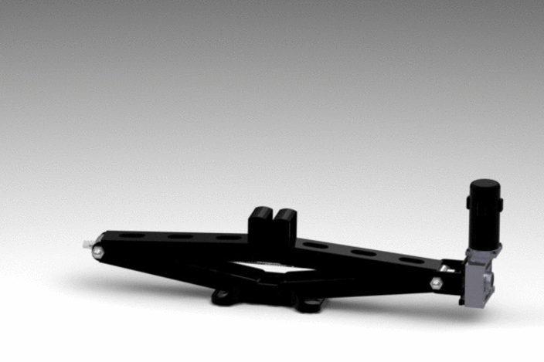
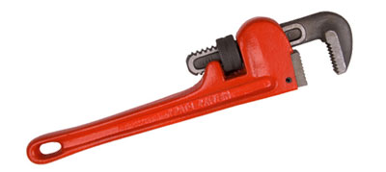
Screw Gear (Two types)
Nut and a screw

Slide 52
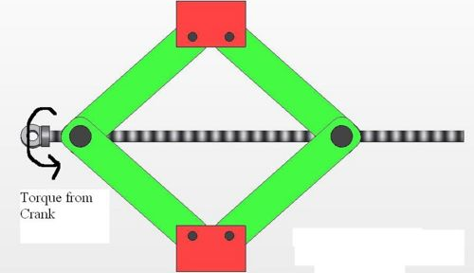
Screw Gear Systems: Type 1 Use
Car Jack
The Screw is turned, which allows for translational motion of the jack to rise

Slide 53
Screw Gear Systems: Type 2 Use
Wrench
It’s the nut that does the initial rotational movement

Slide 54
Screw Gear Systems (2 Types)
Contains a screw and a nut
Initial Motion: Rotational Final Motion: Translational
Type 1: The Screw is the driver (nut is the driven)
Type 2: The Nut is the driver (screw is the driven)

Slide 55
Screw Gear Systems
Considerations
  The threads of the screws and nuts must match.
  Type I: the nut must be connected to the screw in such a way that the nut cannot rotate.
  Type II: the nut must be fixed in such a way that the only possible motion is rotational motion.

Slide 56
Worksheets
Work in pairs or individually
After 20 minutes:
  Hand-in Motion Transmission/Speed Changes Worksheet (from last class)
  Hand-in Motion Systems Worksheet from this class.
PLEASE PUT YOUR NAME ON BOTH.
Be ready for the final level…

