Slide 1
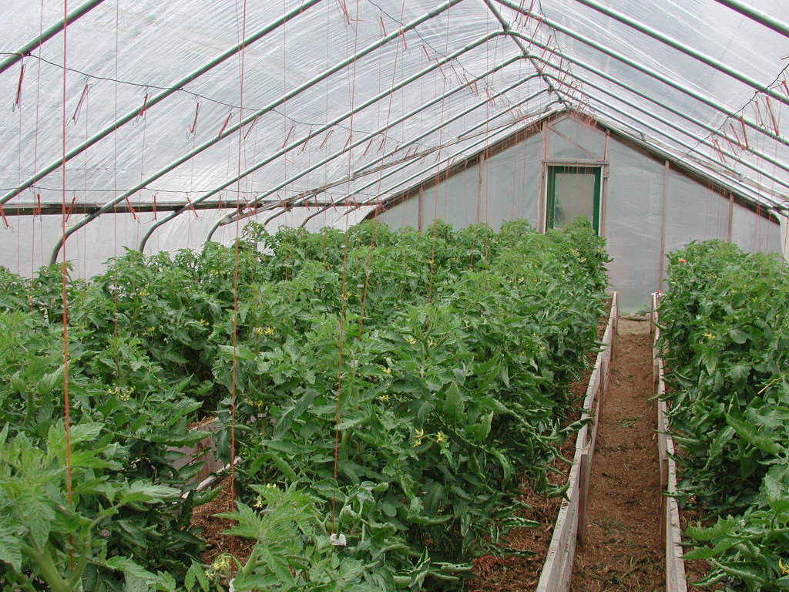
Greenhouse Effect

Slide 2
Greenhouse Effect
A natural process by which gases in the atmosphere absorb and re-radiate thermal radiation from the planet’s surface.
Solar radiation travels to the Earth; some is reflected back into space.
1
2
Radiation is absorbed by the Earth, thermal radiation is emitted back into the air.
3
Thermal radiation from the Earth is absorbed by greenhouse gases, then re-emitted in all directions .
Atmosphere
Earth

Slide 3
Greenhouse Effect
Main Greenhouse Gases on Earth:
Water vapour, $H_{2}O$
Carbon dioxide, ${CO}_{2}$
Methane, ${CH}_{4}$
Nitrous oxide, $N_{2}O$
Ozone, $O_{3}$

Slide 4
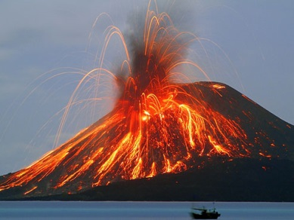
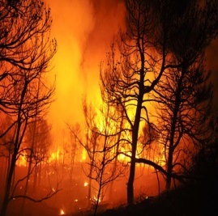
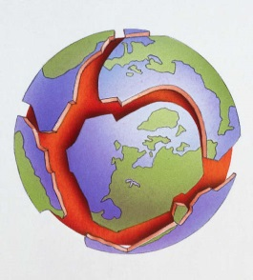
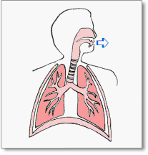
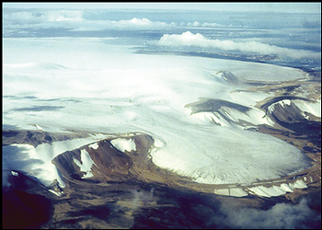
Greenhouse Effect
Greenhouse gases help keep the Earth warm; without them the Earth’s temperature would average around $−18℃$ (cold, even by Canadian standards).
Greenhouse gases have always been produced naturally.
Volcanic activity releases carbon dioxide, ${CO}_{2},$ and other gases into the atmosphere.
Forest fires (which often occur naturally) also release ${CO}_{2}$.
Movement of tectonic plates (which causes earthquakes) releases both methane, ${CH}_{4}$, and carbon dioxide, ${CO}_{2}$.
The thawing of permafrost also results in the release ${CH}_{4}$ and ${CO}_{2}$.
Cellular respiration (humans breathing) produces ${CO}_{2}$.

Slide 5
Greenhouse Effect
Increase greenhouse gases$→$Increase global warming
Human activities that contribute to greenhouses gases:
Carbon dioxide, ${CO}_{2}$

Slide 6
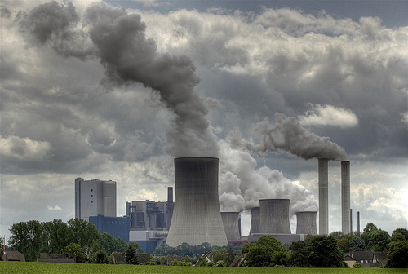
Greenhouse Effect
Increase greenhouse gases$→$Increase global warming
Human activities that contribute to greenhouses gases:
Carbon dioxide, ${CO}_{2}$
Electricity: Burning fossil fuels to generate electricity.

Slide 7
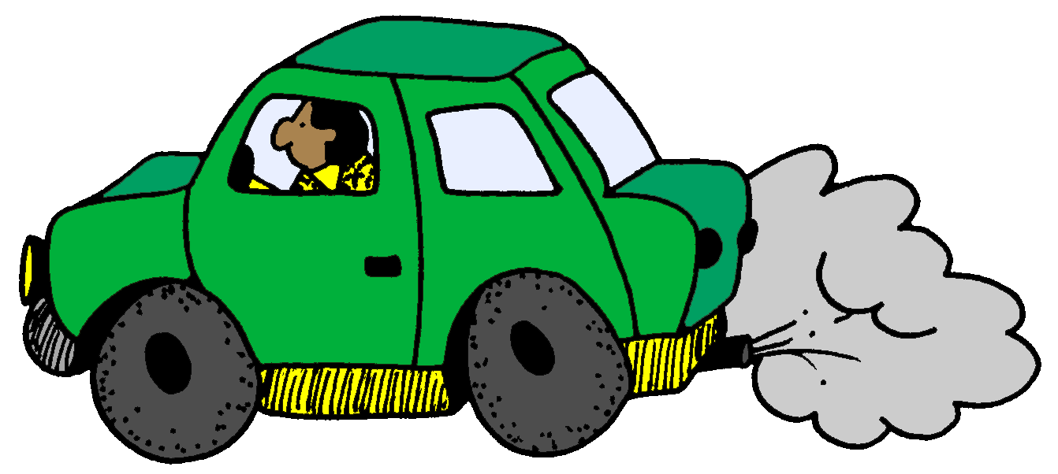
Greenhouse Effect
Increase greenhouse gases$→$Increase global warming
Human activities that contribute to greenhouses gases:
Carbon dioxide, ${CO}_{2}$
Electricity: Burning fossil fuels to generate electricity.
Transportation: Burning gasoline in cars and trucks, etc…

Slide 8
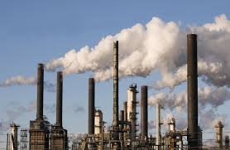
Greenhouse Effect
Increase greenhouse gases$→$Increase global warming
Human activities that contribute to greenhouses gases:
Carbon dioxide, ${CO}_{2}$
Electricity: Burning fossil fuels to generate electricity.
Transportation: Burning gasoline in cars and trucks, etc…
Industry: Fossil fuel combustion for industrial processes.

Slide 9
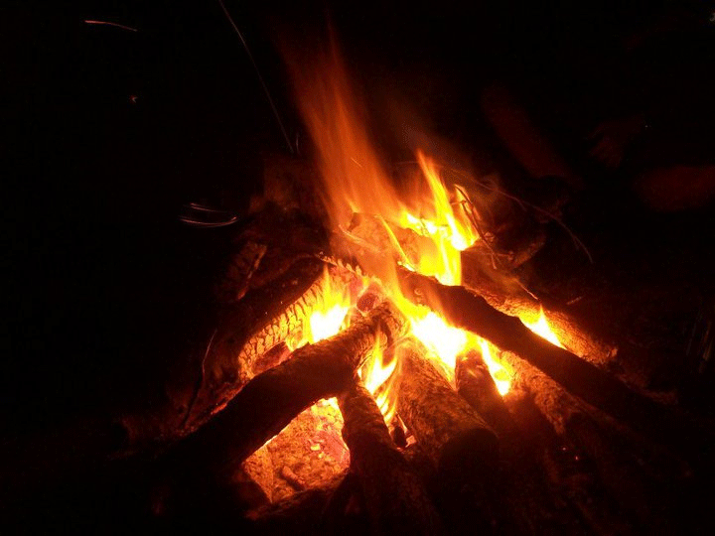
Greenhouse Effect
Increase greenhouse gases$→$Increase global warming
Human activities that contribute to greenhouses gases:
Carbon dioxide, ${CO}_{2}$
Electricity: Burning fossil fuels to generate electricity.
Transportation: Burning gasoline in cars and trucks, etc…
Industry: Fossil fuel combustion for industrial processes.
Heating: Burning wood or oil for heat.

Slide 10
Greenhouse Effect
Increase greenhouse gases$→$Increase global warming
Human activities that contribute to greenhouses gases:
Methane, ${CH}_{4}$

Slide 11
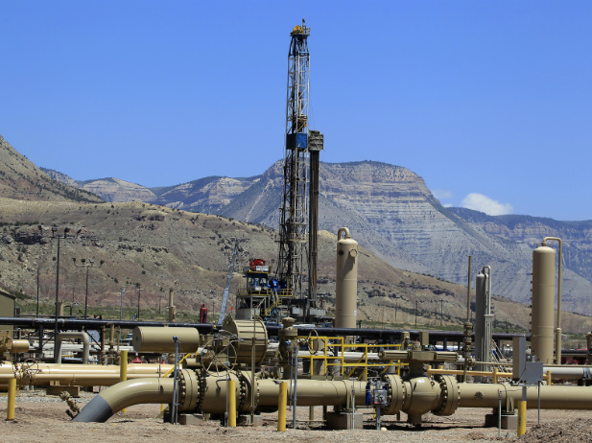
Greenhouse Effect
Increase greenhouse gases$→$Increase global warming
Human activities that contribute to greenhouses gases:
Methane, ${CH}_{4}$
Industry: During the production and processing of natural gas.

Slide 12
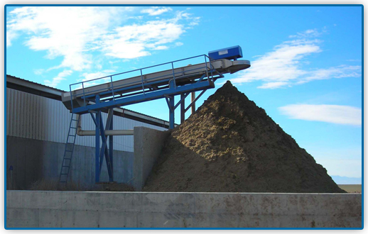
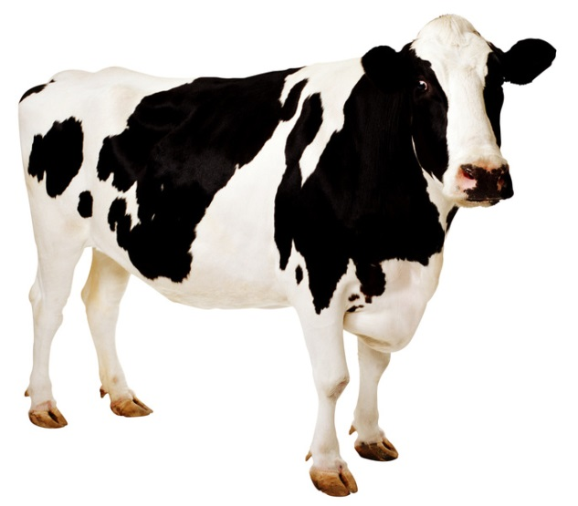
Greenhouse Effect
Increase greenhouse gases$→$Increase global warming
Human activities that contribute to greenhouses gases:
Methane, ${CH}_{4}$
Industry: During the production and processing of natural gas.
Agriculture: Livestock and manure storage.

Slide 13
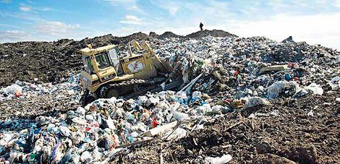
Greenhouse Effect
Increase greenhouse gases$→$Increase global warming
Human activities that contribute to greenhouses gases:
Methane, ${CH}_{4}$
Industry: During the production and processing of natural gas.
Agriculture: Livestock and manure storage.
Waste: Decomposition of household and business waste in landfills.

Slide 14
Greenhouse Effect
Increase greenhouse gases$→$Increase global warming
Human activities that contribute to greenhouses gases:
Nitrous oxide, $N_{2}O$

Slide 15
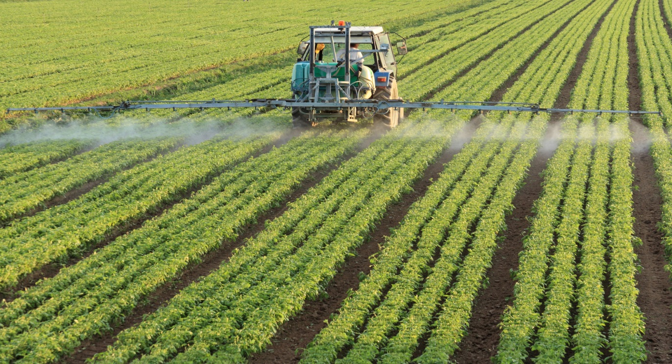
Greenhouse Effect
Increase greenhouse gases$→$Increase global warming
Human activities that contribute to greenhouses gases:
Nitrous oxide, $N_{2}O$
Agriculture: The use of synthetic fertilizers.

Slide 16
Greenhouse Effect
Increase greenhouse gases$→$Increase global warming
Human activities that contribute to greenhouses gases:
Nitrous oxide, $N_{2}O$
Agriculture: The use of synthetic fertilizers.
Transportation: Burning gasoline in cars and trucks, etc…

Slide 17
Is there anything that helps counter greenhouse gas levels?

Slide 18
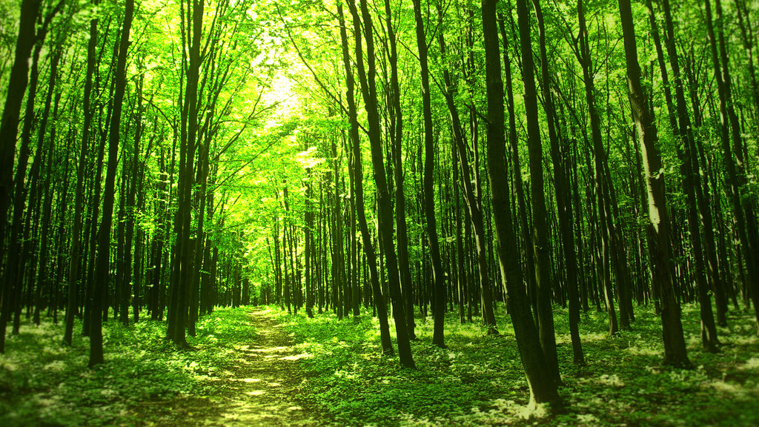
Photosynthesis: ${CO}_{2}$ is absorbed and converted into glucose ${C_{6}H_{12}O}_{6}$ and oxygen gas, $O_{2}$.
$6{CO}_{2}+6H_{2}O$(+ solar energy)$→C_{6}H_{12}O_{6}+6O_{2}$

Slide 19
Carbon dioxide, ${CO}_{2}$, is absorbed/dissolved into the hydrosphere.
${CO}_{2}$ is absorbed (through photosynthesis) by aquatic organisms (phytoplankton) and plants.
${CO}_{2}$ reacts with water and calcium, forming calcium carbonate, ${CaCO}_{3},$ a compound used in the formation of shells and skeletons of marine organisms.

