Slide 1
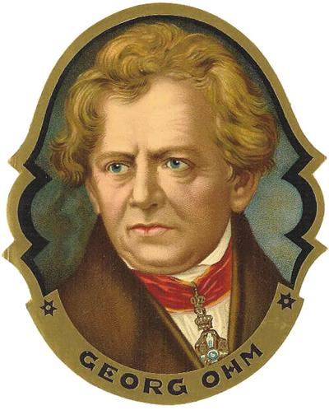
V vs I
Resistance
Voltage
Current

Slide 2
Math Class
Electricity
y
V
Slope = a
Slope = R
y =
a x
V =
R I
x
I

Slide 3
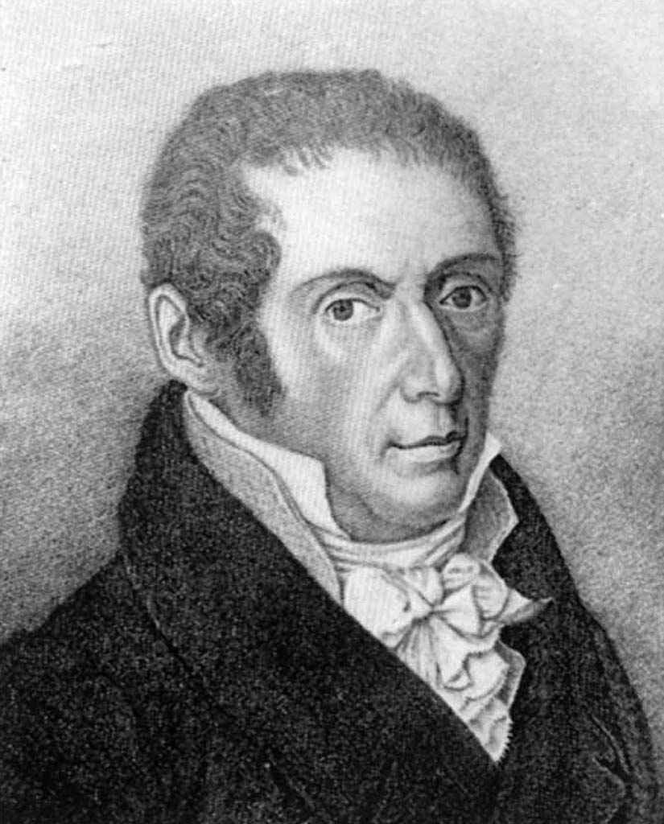
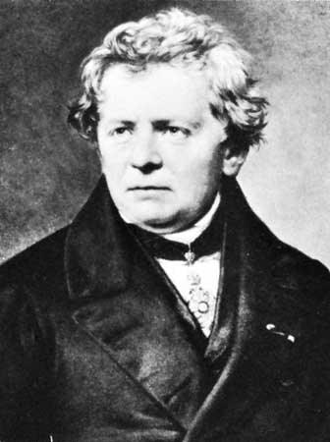
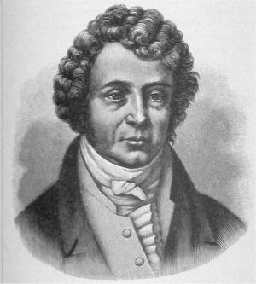
Mathematical relation between Voltage, Resistance and Current
Ohm’s Law
V
R
I
=
$$×$$
in Volts (V)
in Ohms ($Ω$)
in Amps ($A$)
Alessandro Volta
Georg Ohm
André-Marie Ampère

Slide 4
Example I:
What current will travel through a component that has a resistance of 60 Ω if it is connected to a 12 V battery?
I = ?
V = R I
R = 60 Ω
12
60
=
I
V = 12 V
60
60
0.2
I
=
A

Slide 5
Example II:
What reading should appear on the voltmeter in the circuit below?
A
20 Ω
V

Slide 6
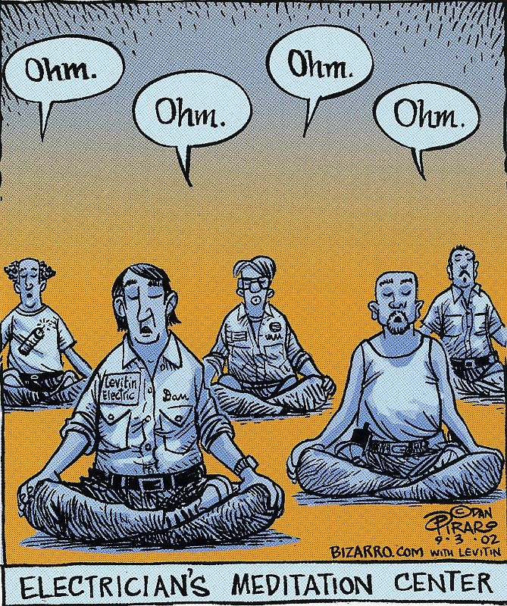
Example II:
What reading should appear on the voltmeter in the circuit below?
I = 70 mA
A
20 Ω
V

Slide 7
Example II:
What reading should appear on the voltmeter in the circuit below?
V = ?
R = 20 Ω
I = 70 mA
0.07
I = 70 mA
= ______ A
A
V = R I
20 Ω
V
V =
( 20 )
( 0.07 )
V =
1.4
V

Slide 8
Example III:
The human body has an electrical resistance of about 10 kΩ. (it actually can vary from 1 kΩ – 100 kΩ)
Refer to the given chart to determine the (usual) effect of touching an uninsulated wire from a 120 V outlet.
I (mA) | Effect on a person
0.5 - 3 | Tingling sensations
3 - 10 | Muscle contractions and pain
10 - 40 | ‘Let-go’ threshold
30 - 75 | Respiratory paralysis
100 - 200 | Ventricular fibrillation (Death)
200 - 500 | Heart clamps tight
1500+ | Tissues and organs burn

Slide 9
Example III:
The human body has an electrical resistance of about 10 kΩ. (it actually can vary from 1 kΩ – 100 kΩ)
Refer to the given chart to determine the (usual) effect of touching an uninsulated wire from a 120 V outlet.
R = 10 kΩ
10 000
= _______ Ω
V = 120 V
I (mA) | Effect on a person
0.5 - 3 | Tingling sensations
3 - 10 | Muscle contractions and pain
10 - 40 | ‘Let-go’ threshold
30 - 75 | Respiratory paralysis
100 - 200 | Ventricular fibrillation (Death)
200 - 500 | Heart clamps tight
1500+ | Tissues and organs burn
I = ?
V = R I
120 =
10 000
I
10 000
10 000
I =
0.012
A
I =
12
mA

Slide 10
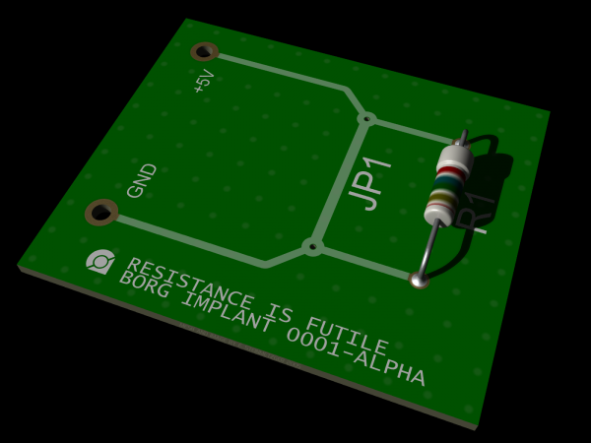

Slide 12
