Slide 1
Dynamic Electricity
Conductance / Resistance / Factors

Slide 2
Conductance
Conductance:
A measure of the ability to carry electric charge.
High conductance $→$ G$ood conductor$
$→$ Easy for electricity to travel through
Low conductance $→$ Poor conductor

Slide 3
Resistance

Slide 4
Resistance
is futile …

Slide 5
Resistance
Resistance:
A measure of the opposition to the flow of electricity.
High r$esistance→$ P$oor conductor$
$→$ Hard for electricity to travel through
Low r$esistance→$ Good conductor
Symbol for Resistance (used in formulas):
R
Ohms ;
Symbol: $Ω$
Unit (resistance is measured in …):
Greek letter Omega

Slide 6
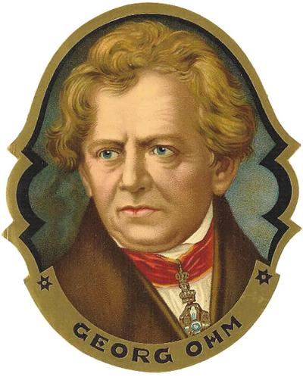
Example:
Measure
Value
Unit
R$=270 Ω$
Resistance equal to 270 ohms
V$=750$ mL
Same idea as:
Measure
Value
Unit

Slide 7
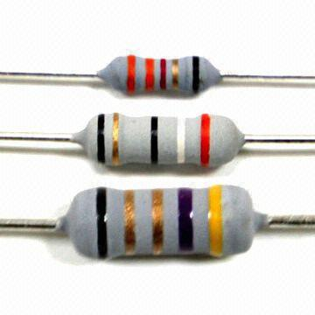
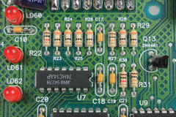
A Resistor (in an electric circuit) is a component that limits the flow of electric charge (electrons).
Schematic symbol for a resistor:
Resistors:

Slide 8
The higher the resistance value, the less electric current there is flowing through the circuit.
Lower
Resistor
Value
Higher
Resistor
Value

Slide 9
The higher the resistance value, the less electric current there is flowing through the circuit.
Lower resistance $⇒$ more current $⇒$ brighter light.
Lower
Resistor
Value
Higher
Resistor
Value

Slide 10
Factors that affect Conductance / Resistance
1)
Material:
Some materials conduct electricity better than others.
Copper $→$ Very good conductor $→$ Low electrical resistance
2)
Length:
Shorter wire $→$ Better conductor $→$ Lower resistance
(Less distance for electrons to travel)
3)
Diameter:
Larger diameter $→$ Better conductor $→$ Lower resistance
(More room for electrons to travel through)
4)
Temperature:
Lower temperature $→$ Better conductor $→$ Lower resistance
(Atoms more structured; less random motion)

Slide 11
What makes a good conductor?
Think of Santa!
Short
Large diameter
Likes the cold
Gold belt buckle

Slide 12
