Slide 1
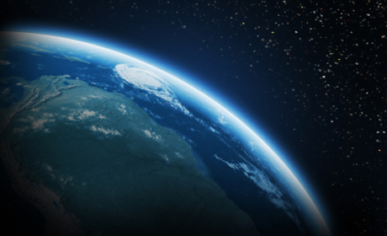
Atmosphere

Slide 2
Atmosphere (Vapour Sphere)
Layer of air surrounding the Earth
21%
Oxygen , $O_{2}$
78%
Nitrogen, $N_{2}$
Other:
Water vapour, $H_{2}O$
Argon, $Ar$
Carbon dioxide, $CO_{2}$
Neon, $Ne$
Helium , $He$
Methane, $CH_{4}$
Krypton, $Kr$
etc…

Slide 3
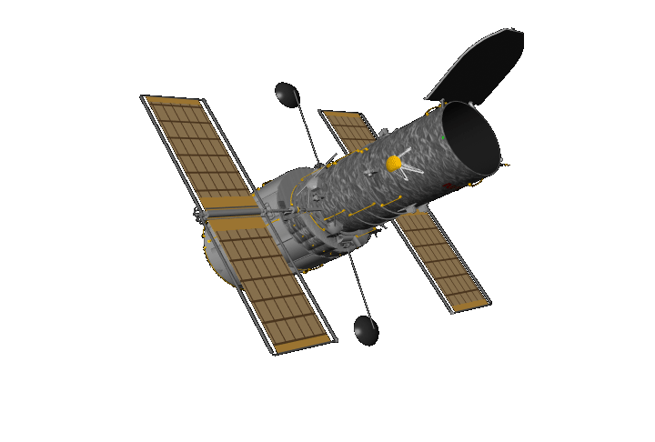
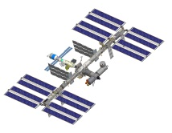
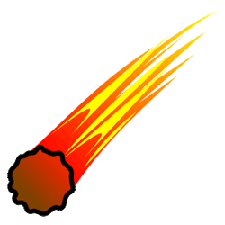
Atmosphere (Layers)
Exosphere
500 km
Thermosphere
80 km
Mesosphere
50 km
Stratosphere
Ozone layer
Troposphere
15 km
Sea level

Slide 4
Atmosphere (Layers)
500 km
Troposphere
(Sphere of Change)
Contains 75% of the mass of the atmosphere.
Contains the cloud formations and storms.
80 km
50 km
Temperature and air pressure drop as altitude increases.
Ozone layer
Troposphere
15 km
Sea level

Slide 5
Atmosphere (Layers)
500 km
Stratosphere
(Stratified Sphere)
Contains the ozone layer which absorbs harmful ultraviolet radiation from the sun.
80 km
Temperature increases as altitude increases (due to the ozone layer).
50 km
Stratosphere
Ozone layer
15 km
Sea level

Slide 6
Atmosphere (Layers)
500 km
Mesosphere
(Middle Sphere)
Coldest layer of the atmosphere; temperature drops as altitude rises (as low as $−100℃$ at the top).
80 km
Mesosphere
Contains very few air molecules.
50 km
Ozone layer
15 km
Sea level

Slide 7
Atmosphere (Layers)
500 km
Thermosphere
(Sphere of Heat)
Thermosphere
Hottest layer of the atmosphere; temperature increases with altitude (as high as $2000℃$ ).
Most of the sun’s rays absorbed in this layer (polar auroras usually form in this layer).
80 km
50 km
International Space Station orbits (altitude ~400 km).
Ozone layer
15 km
Sea level

Slide 8
Atmosphere (Layers)
Exosphere
500 km
Exosphere
(External Sphere)
Extremely few air molecules (almost a vacuum).
Most satellites orbit in this layer.
80 km
50 km
Ozone layer
15 km
Sea level

Slide 9
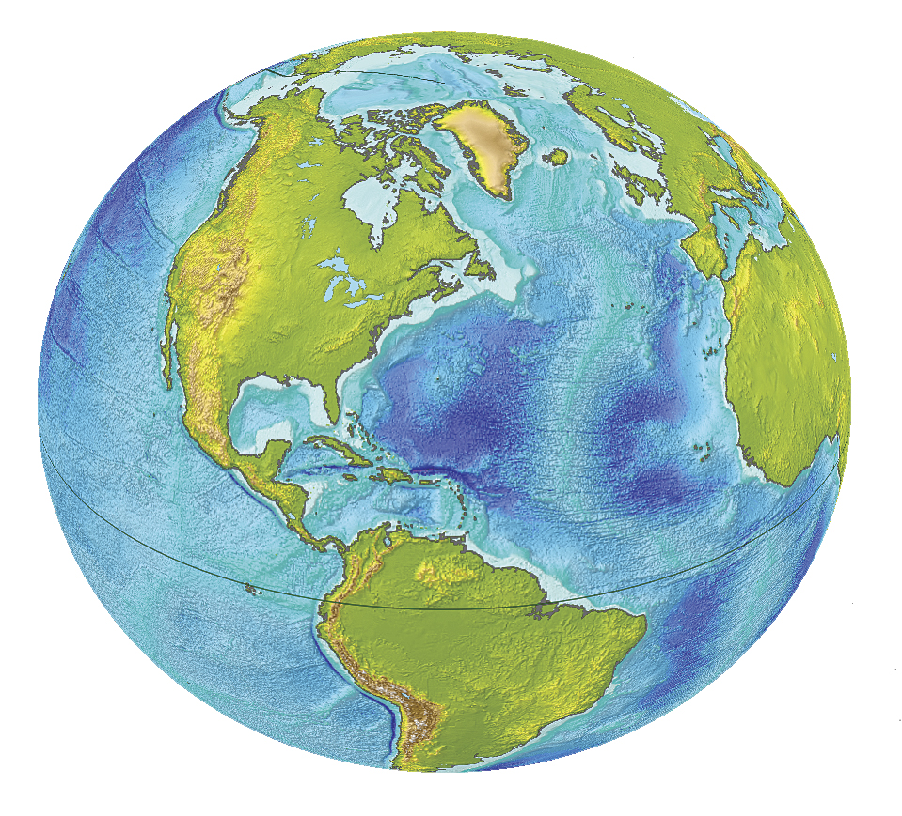
Atmosphere (to scale)
Troposphere
(75% of our atmosphere’s mass; includes clouds, etc…)
Satellites orbit

Slide 10
Atmospheric Pressure
The pressure of the air in the atmosphere
The more particles (molecules of air), the higher the pressure
High Pressure
Low Pressure
(Crowded; many molecular collisions)
(Molecules further apart; fewer collisions)
Air particles tend to move from high-pressure to low-pressure areas.
This movement gives rise to winds.

Slide 11
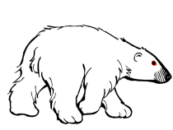
Atmospheric Circulation
Global movement of air surrounding the Earth
Warmer air (less dense) rises above cooler air.
Air tends to move from high pressure to low pressure.
Warmer air at the equator tends to rise, leaving behind a lower pressure zone near the surface.
Cooler air moves in from higher pressure areas (from the north and south; this helps balance the temperature on Earth).

Slide 12
Atmospheric Circulation
Global movement of air surrounding the Earth
Coriolis Effect: Air circulation is also affected by the fact that the Earth is spinning, causing air to take a curved path. (Circulation tends to be clockwise in the northern hemisphere, and counter-clockwise in the southern hemisphere)

Slide 13
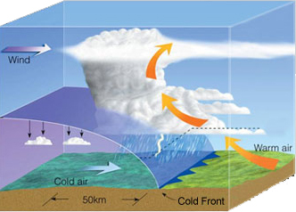
Atmospheric Circulation
Air Mass: A large portion of atmosphere that has a relatively uniform temperature and humidity.
Cold Front
Cold air mass moves into a warm air mass.
Warm air rises rapidly, cools, forms clouds, and often produces heavy rain.

Slide 14
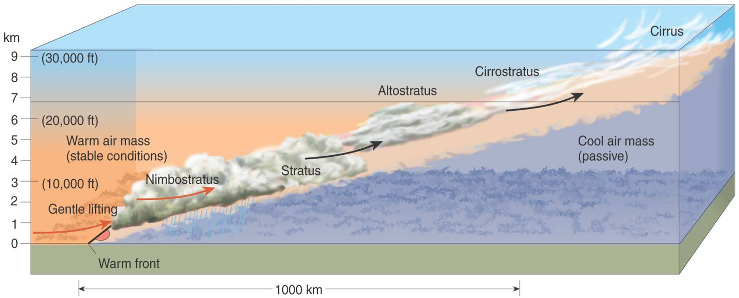
Atmospheric Circulation
Air Mass: A large portion of atmosphere that has a relatively uniform temperature and humidity.
Warm Front
Warm air mass moves into cold air, rises gradually over the cold air, forming light, stratified clouds. (often results in long-lasting showers)

Slide 15
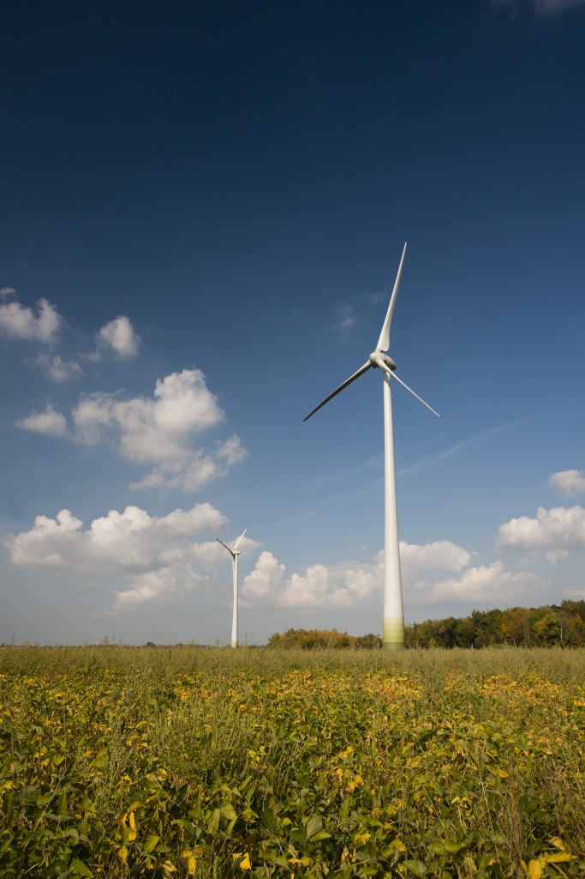
Energy Resources in the Atmosphere
Wind Power
Motion
Electricity
Wind *Energy
ElectricalEnergy
* Wind energy (moving air) is a form of kinetic energy

Slide 16
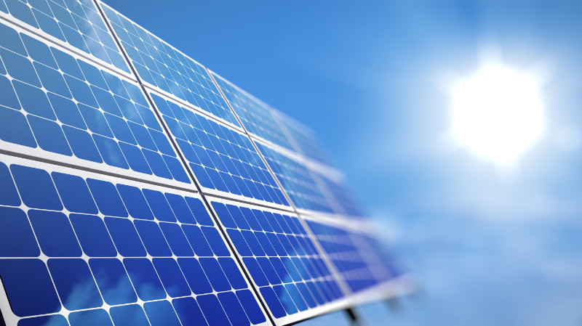
Energy Resources from the Sun
Solar Power
Light
Electricity
Solar Energy
ElectricalEnergy

Slide 17
