Slide 1
Spectroscope Lab

Slide 2
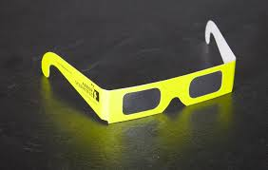
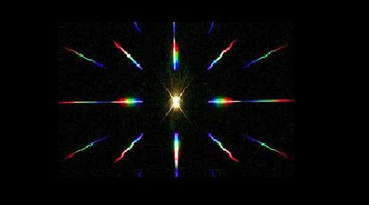
Spectroscope Lab

Slide 3
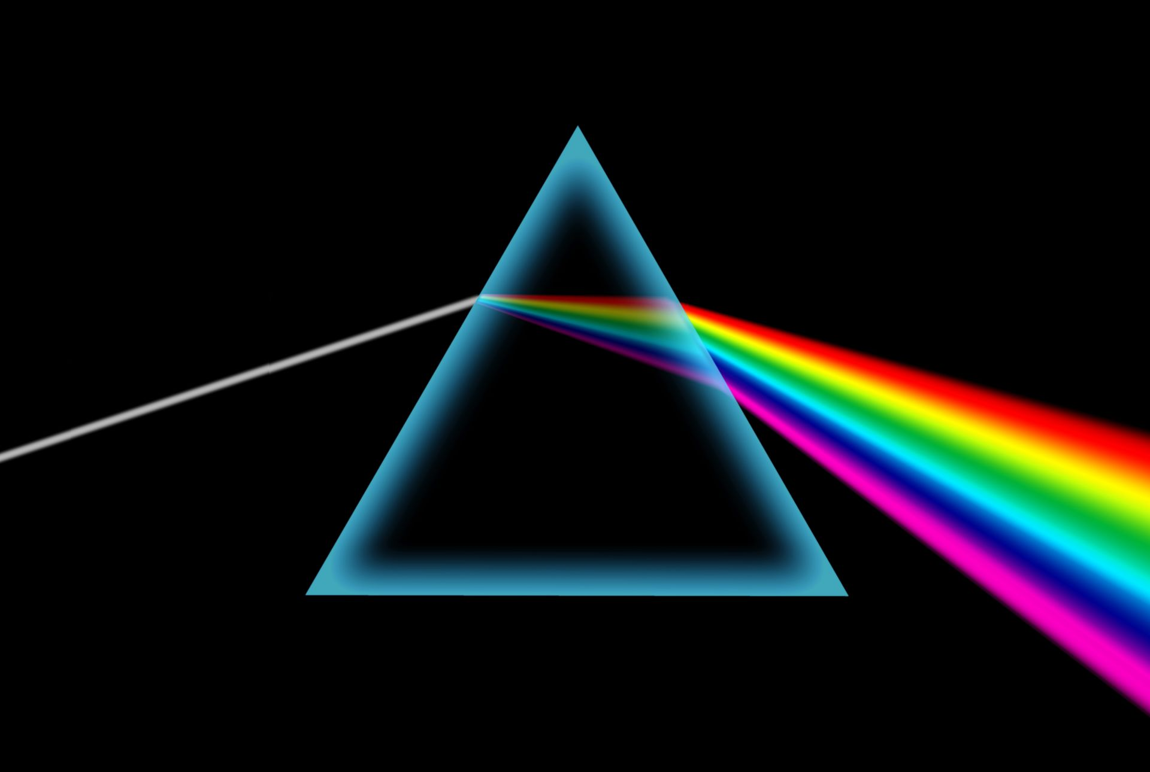
Visible Spectrum

Slide 4
Hydrogen
$$H_{2 (g)}$$

Slide 6
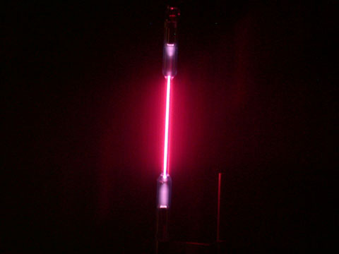
Visible spectrum
Hydrogen
$$H_{2 (g)}$$

Slide 7
Helium
$${He}_{ (g)}$$

Slide 9
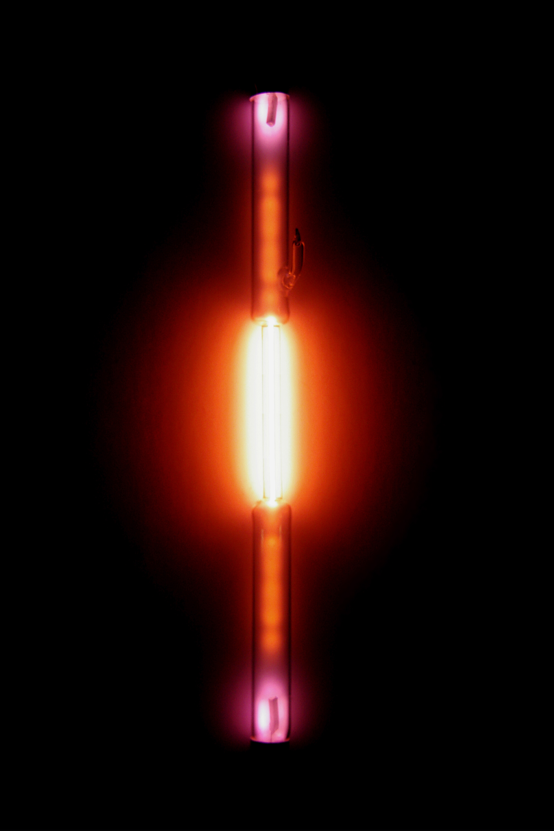
Visible spectrum
Helium
$${He}_{ (g)}$$

Slide 10
Nitrogen
$$N_{2 (g)}$$

Slide 12
Visible spectrum
Nitrogen
$$N_{2 (g)}$$

Slide 13
Oxygen
$$O_{2 (g)}$$

Slide 15
Visible spectrum
Oxygen
$$O_{2 (g)}$$

Slide 16
Neon
$${Ne}_{ (g)}$$

Slide 18
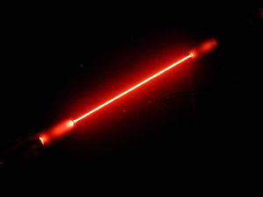
Visible spectrum
Neon
$${Ne}_{ (g)}$$

Slide 19
Mercury
$${Hg}_{ (g)}$$

Slide 21
Visible spectrum
Mercury
$${Hg}_{ (g)}$$

Slide 23
