Slide 1
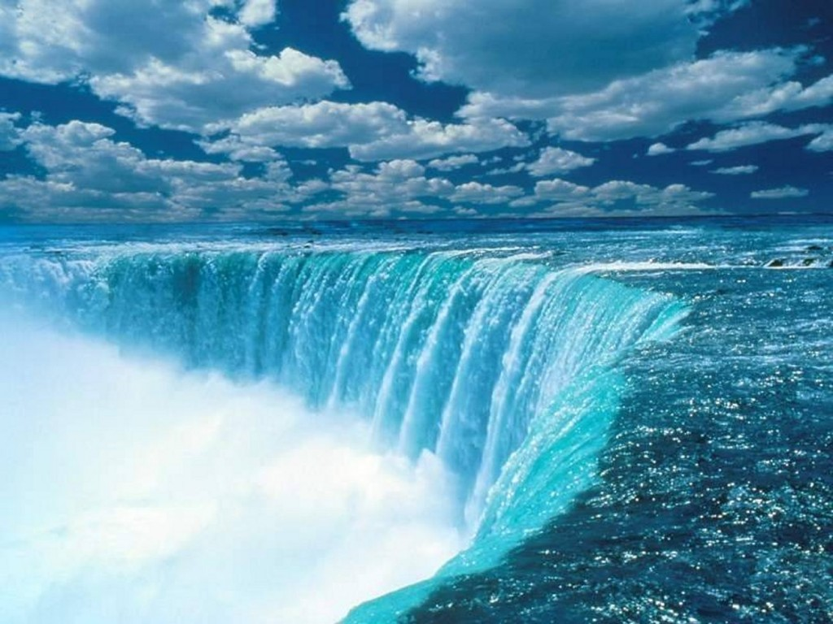
Hydrosphere

Slide 2
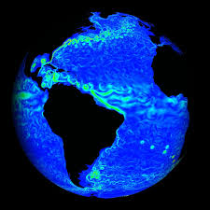
Hydrosphere (Water Sphere): Water of the planet
71 % of the
Earth’s surface

Slide 3
Distribution of Water
97.5 %
2.5 %
79 %
21 %

Slide 4
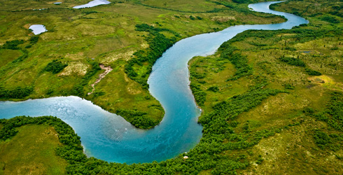
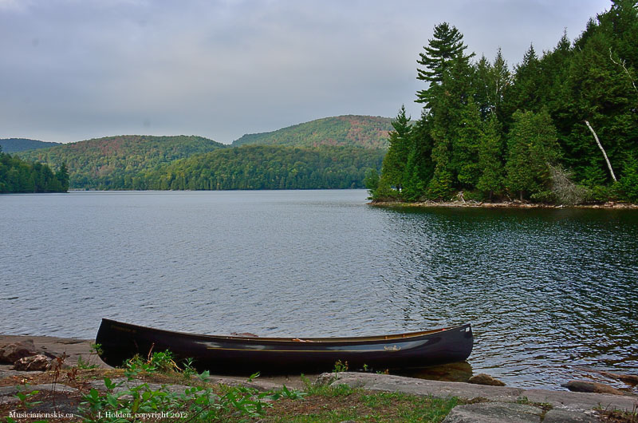
Inland Waters
All freshwater bodies found on continents (includes rivers, lakes, and groundwater)

Slide 5
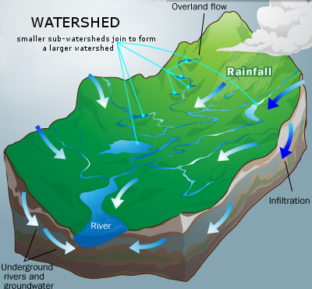
Inland Waters
Watershed
(Also known as Catchment area or Drainage basin)
Area of land in which all inland waters drain into a same larger body of water.
The outline of a watershed is defined by natural boundaries (mountains, hills, etc...)

Slide 6
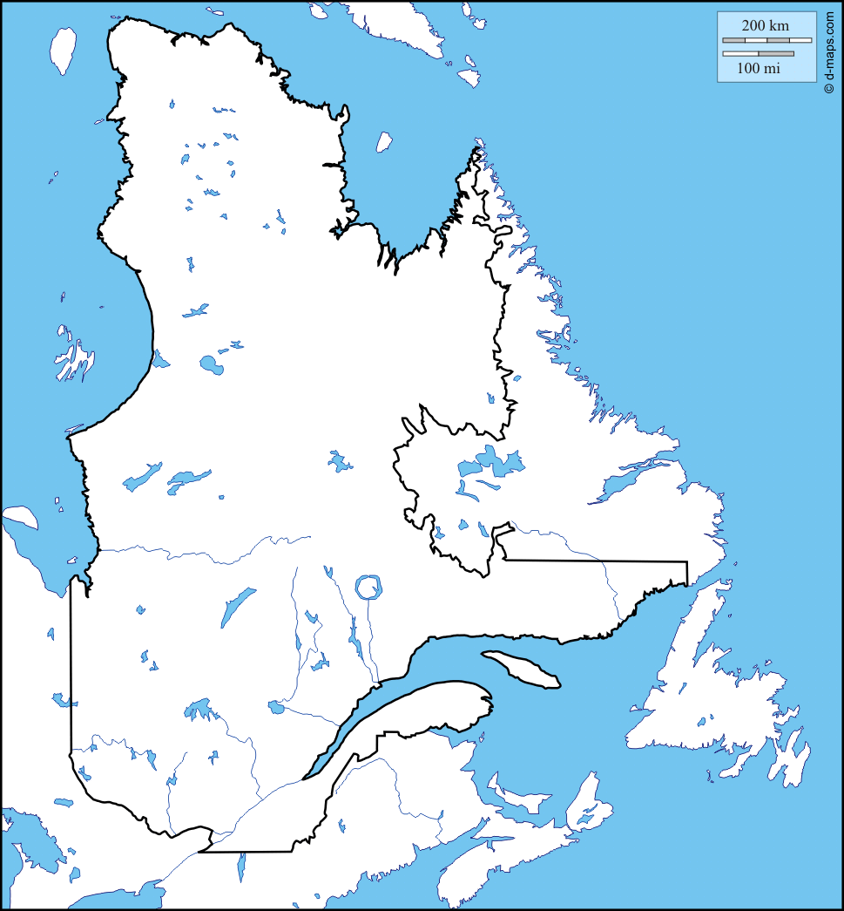
Quebec Watersheds
3 major watersheds of Quebec
Ungava Bay
Watershed
Hudson Bay
Watershed
Each watershed is made up of many smaller watersheds
St. Lawrence River
Watershed

Slide 7
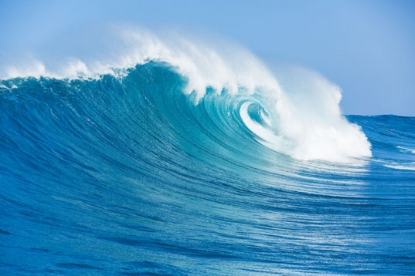
The Oceans

Slide 8
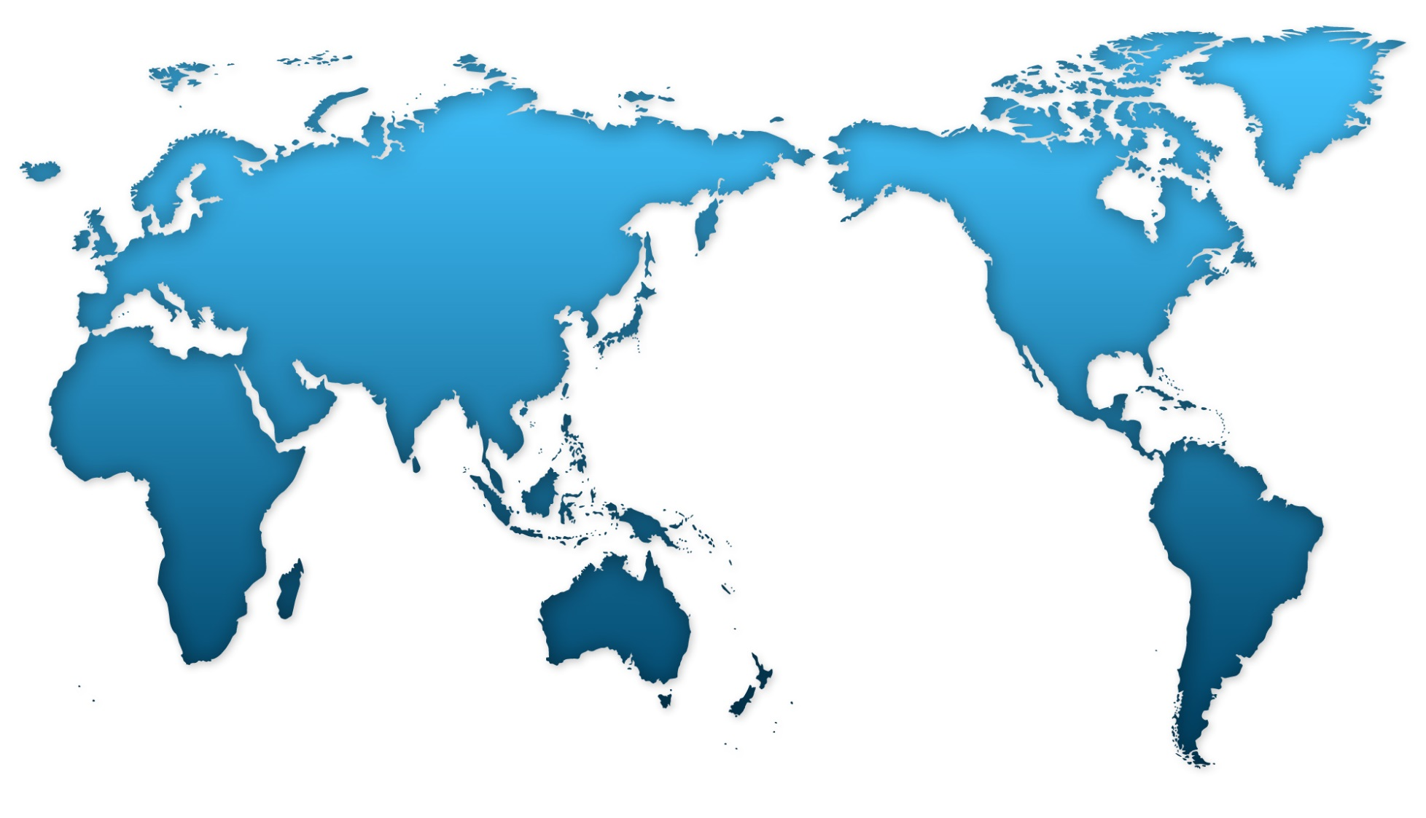
The Oceans
Arctic ocean
Atlantic
ocean
pacific
ocean
Indian
ocean
southern ocean

Slide 9
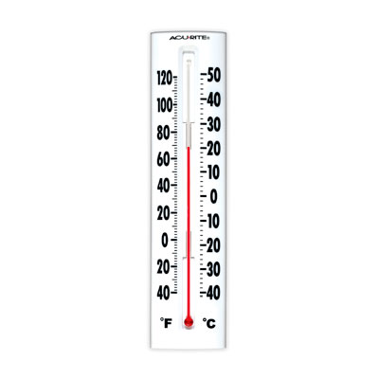
The Oceans
Factors that affect Water Temperature

Slide 10
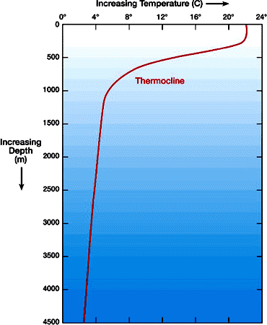
The Oceans
Factors that affect Water Temperature:
Depth
Solar energy is absorbed near the surface of the ocean.
Below a depth of 200m the temperature drops rapidly; this region is called the thermocline.
Active layer
Thermocline
Deep water

Slide 11
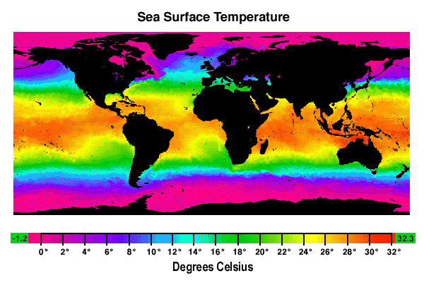
The Oceans
Factors that affect Water Temperature:
Latitude
Surface water averages between $25℃$ and $28℃$ at the equator, and is colder to the north and south.

Slide 12
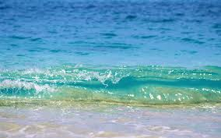
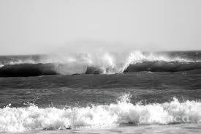
The Oceans
Factors that affect Water Temperature:
Seasons
Surface water temperature will vary from summer to winter.

Slide 13
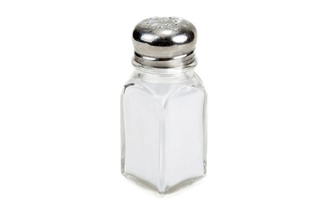
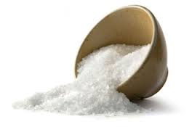
Ocean Salinity
Salinity is a measure of the salt concentration in a liquid.
Average salinity of most oceans is around 3.5%, or 35g/L.
Recall: $C=3.5\%=\frac{3.5g}{100mL}=\frac{3.5g}{0.1L}=\frac{35g}{L}$
(About 10X higher concentration than in a salt water swimming pool)
Salinity is lower near the poles (melting glaciers and pack ice dilute the water)
Salinity is higher in regions that are hot and dry (increased evaporation of water)

Slide 14
Ocean Currents
The movement of seawater in a certain direction
2 main types of currents:
Surface Currents: Mainly wind driven; horizontal.
Subsurface Currents: Motion mainly due to differences in density (higher density water will sink).
Higher salinity water is more dense, and will sink below less dense water.
Cold water is generally more dense, and will sink in warmer water.

Slide 15
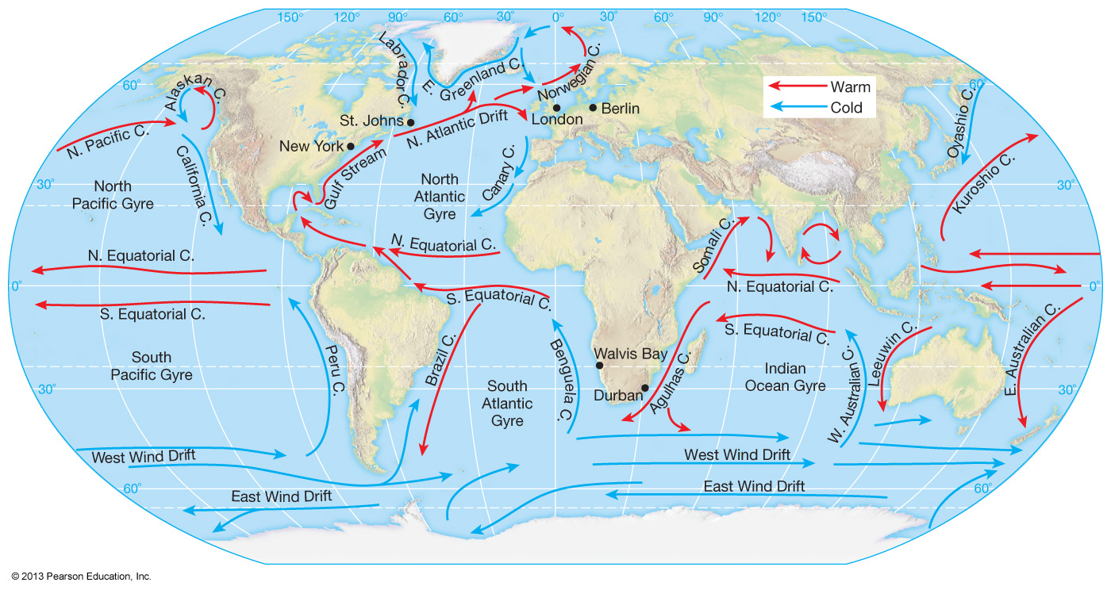
Ocean Currents

Slide 16
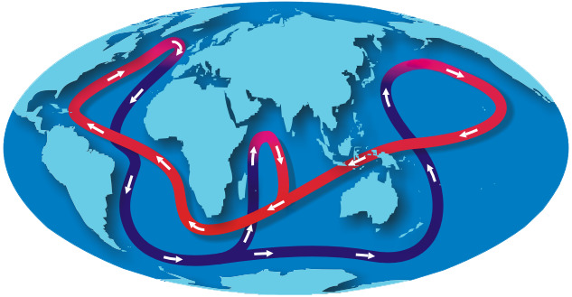
Ocean Circulation
The combined effect of all the currents in the oceans
Thermohaline Circulation:
Surface and subsurface currents are connected together and circulate around the world.

Slide 17
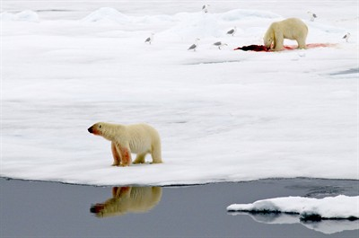
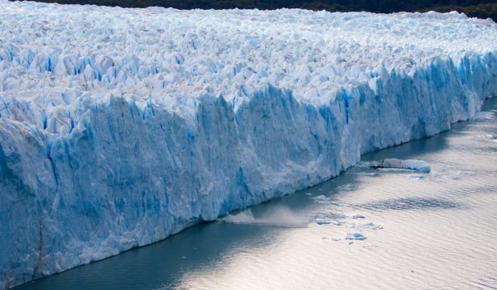
The Cryosphere
The cryosphere consists of all the frozen water on the Earth’s surface
Pack Ice: Ice floating on the oceans near the north and south poles.
Glaciers: Masses of ice on land, formed by compressed snow.

Slide 18
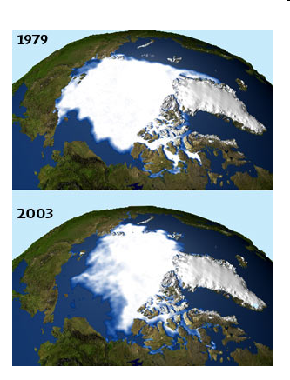
Pack Ice – The North Pole

Slide 19
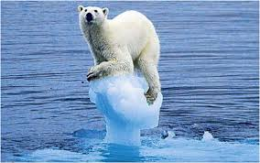
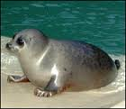
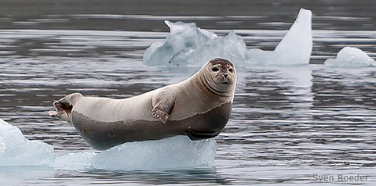
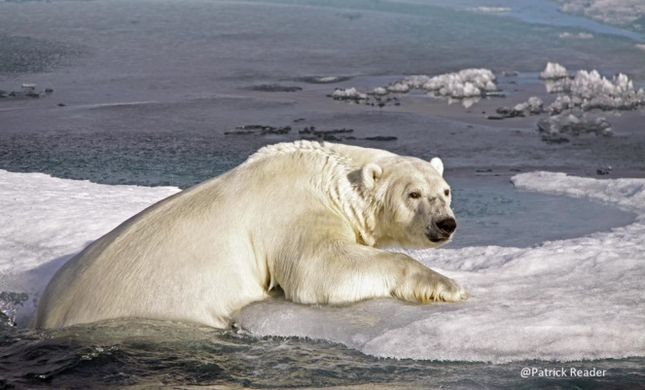
Melting Pack Ice
Melting pack ice threatens the survival of species that depend on the ice.
Note: Melting pack ice does not actually raise sea levels; this is because pack ice is already in the ocean.

Slide 20
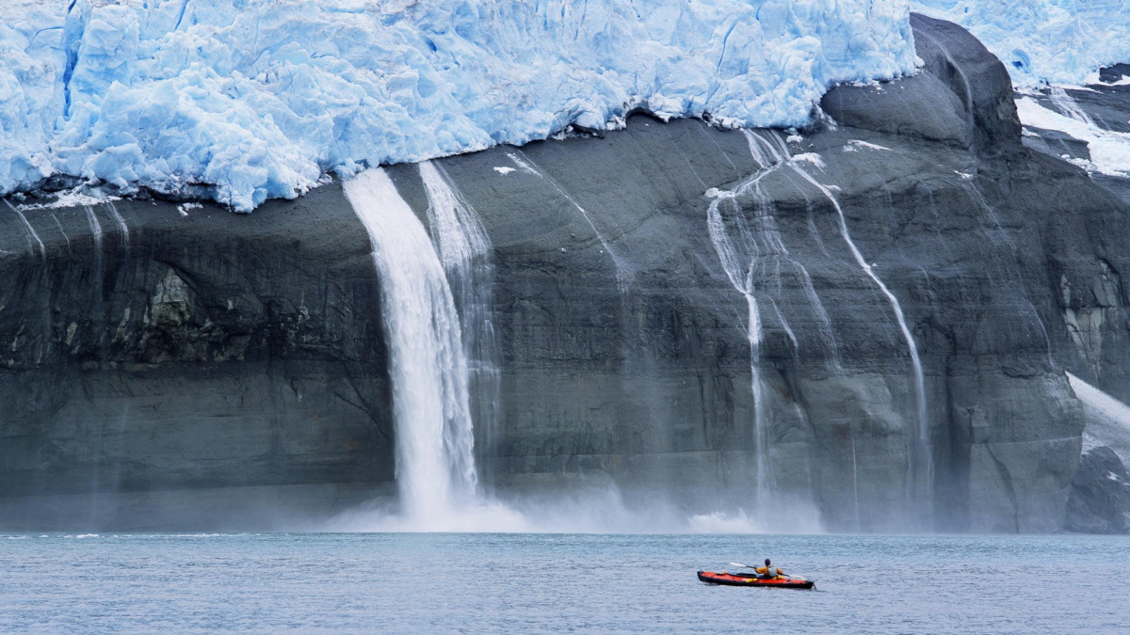
Melting Glaciers

Slide 21
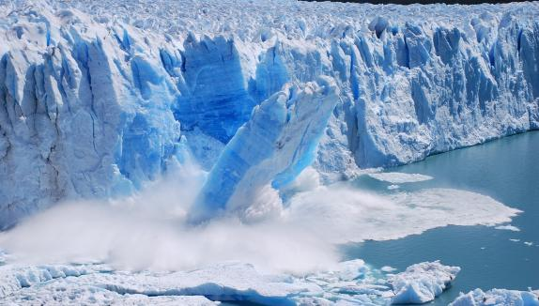
Melting Glaciers

Slide 22
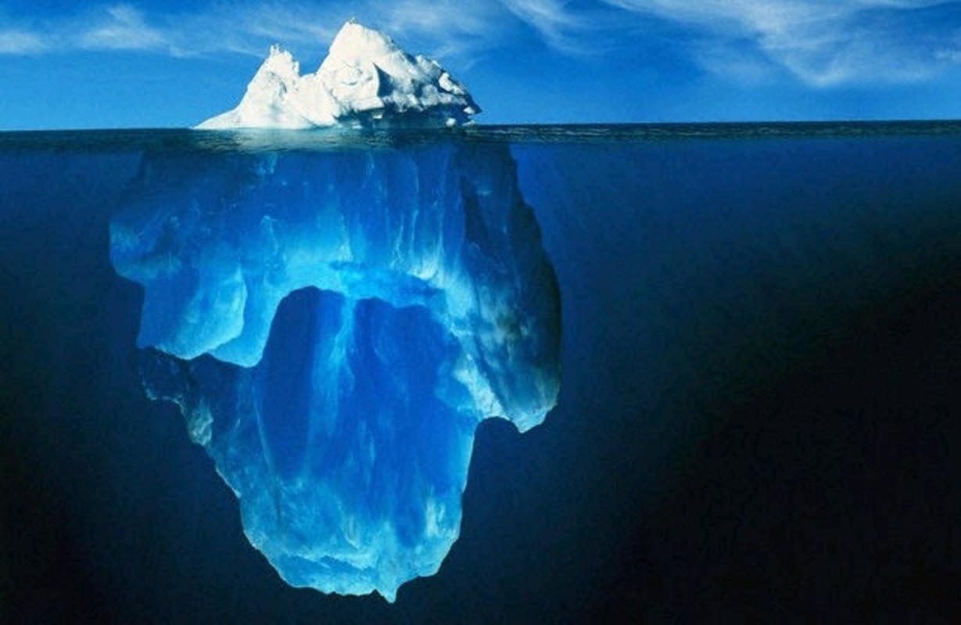
Iceberg
Large piece of ice that has broken off a glacier
Raises the sea level when it falls into the ocean

Slide 23
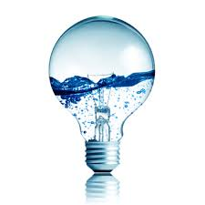
Energy Resources in the Hydrosphere
Hydroelectricity

Slide 24
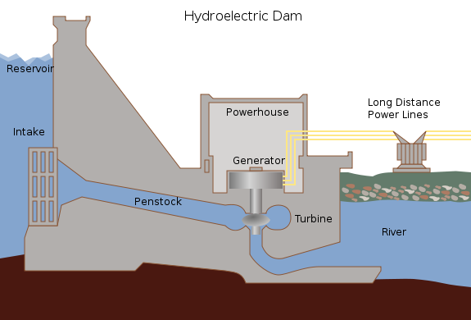
Energy Resources in the Hydrosphere
Hydroelectricity

Slide 25
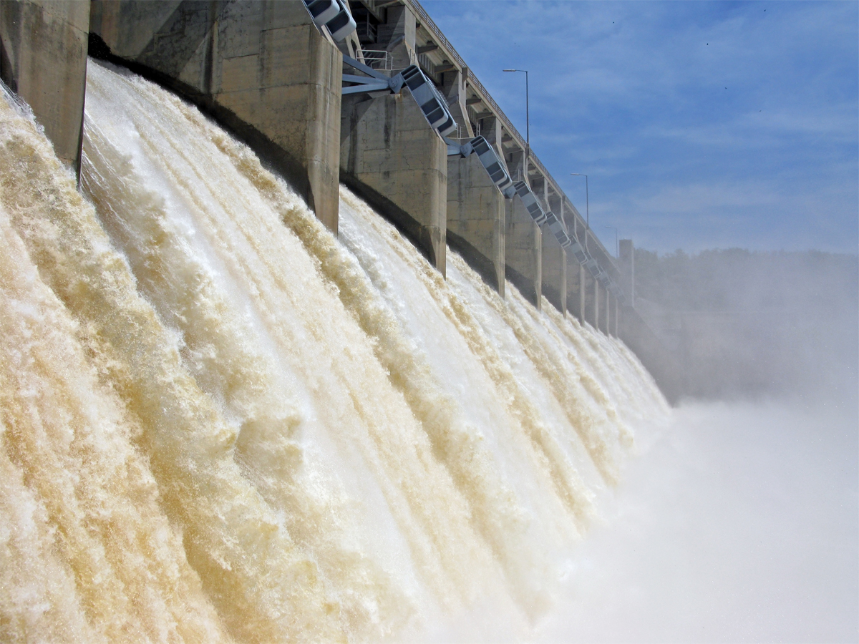
Energy Resources in the Hydrosphere
Hydroelectricity
Beauharnois Power Station
Motion
Electricity
Hydraulic*Energy
ElectricalEnergy
* Hydraulic energy (moving water) is a form of kinetic energy

Slide 26
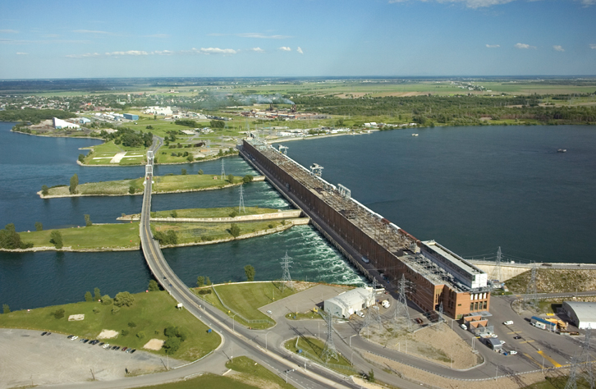
Energy Resources in the Hydrosphere
Hydroelectricity
Beauharnois Power Station

Slide 27
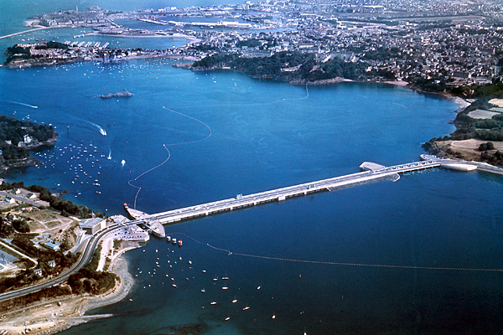
Energy Resources in the Hydrosphere
Tidal Energy
Rance Tidal Power Station, France

Slide 28
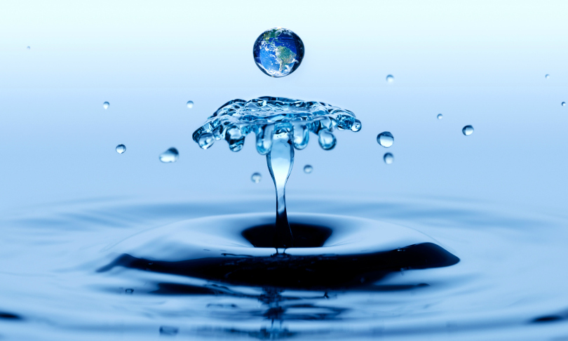
Hydrosphere

