Slide 1
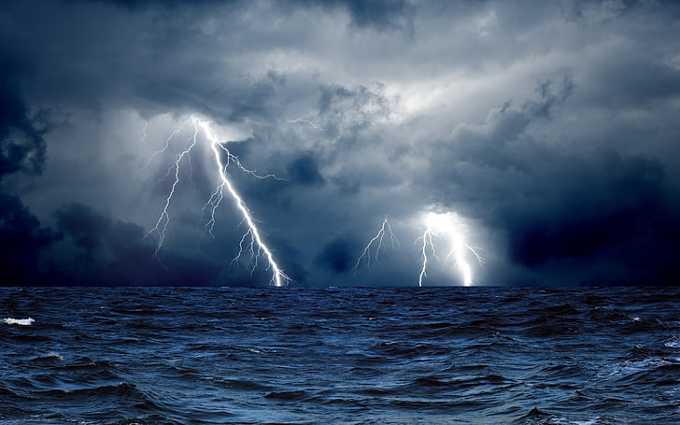
Electrolysis of Water
Lab Report

Slide 2
Electrolysis of Water
Lab Report

Slide 3
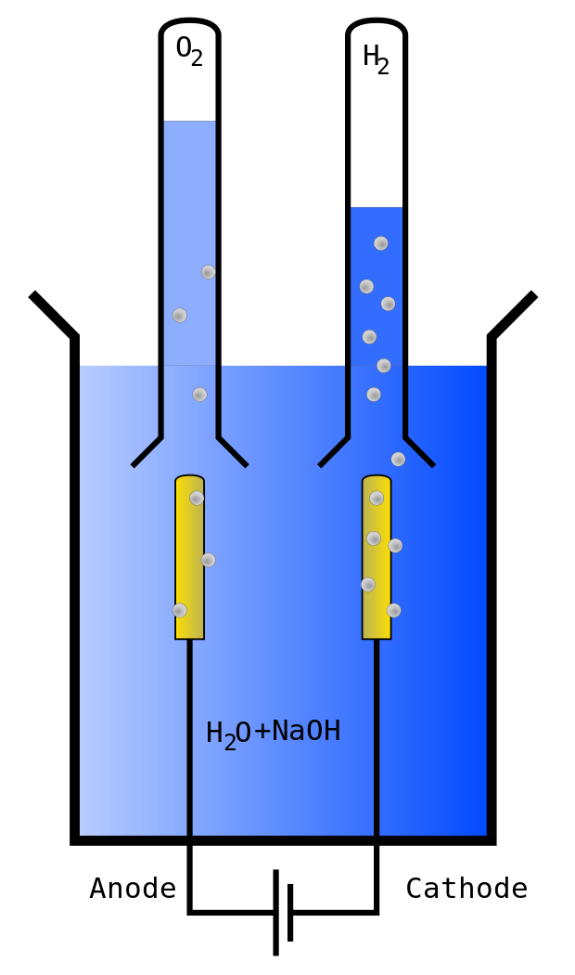
Title Page:
Electrolysis of Water
Laboratory Report
By: Student Name
Course: EST 444-42
Teacher: MacTamgram
Date: Nov. ??, 2019

Slide 4
Title Page:
Electrolysis of Water
Laboratory Report
By: Student Name
Course: EST 444-42
Teacher: MacTamgram
Date: Nov. ??, 2019

Slide 5
Objective:
The purpose of this experiment is
to determine, blah, blah, blah…
Hypothesis:
The elements that make up water
are #$&% and @!*% and are present in a
27:5 ratio, since …
Materials:
Power Supply
Red connecting wire
Black connecting wire
1 all-dressed pizza / extra bacon
Electrolysis tank (1.0 M NaOH solution)
2x 10mL graduated test tubes
2x rubber stoppers (size 00)

Slide 6
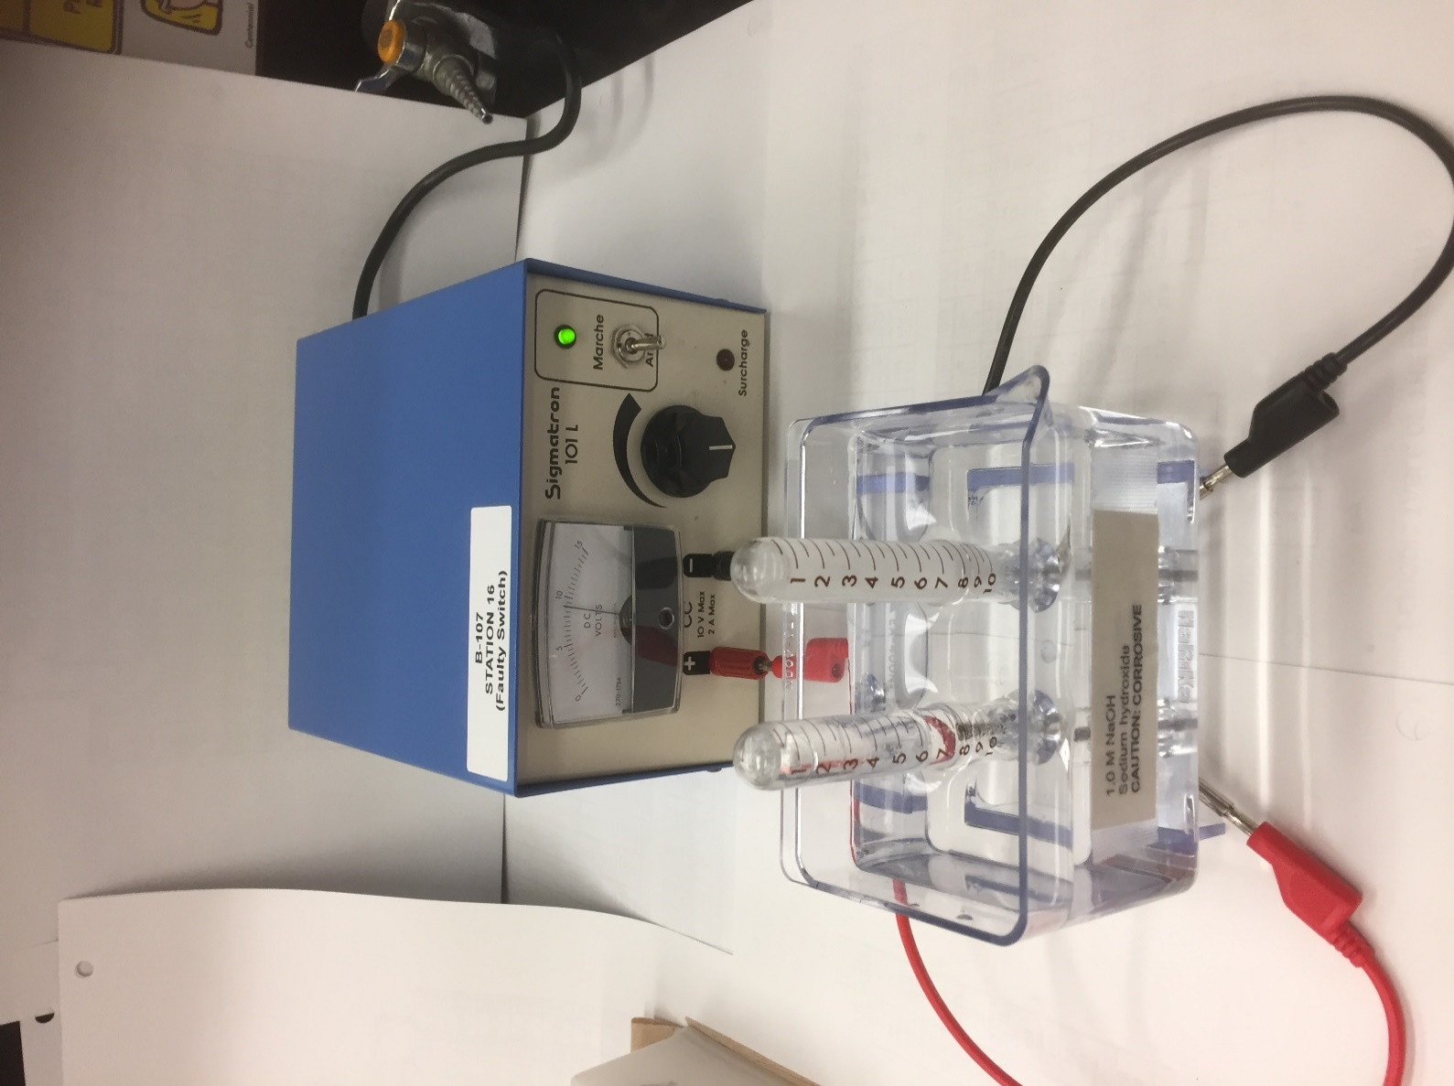
Diagram:
Diagram will be labelled
Power supply
10 mL graduated test tubes
Electrolysis tank
(1.0 M NaOH)

Slide 7
Procedure:
1) blah, blah, blah…
2) mumble, mumble…
3) babble, babble…
4) Repeat step 1.

Slide 8
Observations:
Volumes of gases collected
Volume (+) …
Volume (-) …
(mL)
(mL)
1.0
2.0
3.0
4.0
5.0
Testing the gases collected
Lit splint …
Glowing splint …

Slide 9
Graph:
Volume (mL) gas in ($−$) tube
Volume (mL) gas in (+) tube

Slide 10
Analysis:
1) The gas produced at the ‘+’ electrode …
2) The gas produced at the ‘-’ electrode …
3) Slope Calculation:
P1(x1, y1) P2(x2, y2)
Slope = ….
4) The ratio of the two gases was found …
Conclusion:
The two elements that make up water were found to be _______ and _______, at a ratio of __:__
The data collected (supports/does not…) the hypothesis made.

