Slide 1
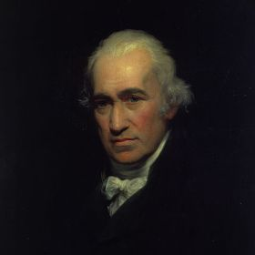
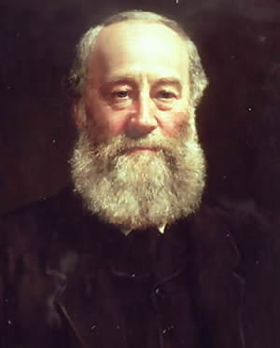
Electrical Power & Energy
James
Prescott
Joule
James
Watt

Slide 2
Power (P):
A measure of the rate of transfer of energy.
Power is measured in
watts
( W )
P = V I
Power
Current
Potential
Difference
( A )
( W )
( V )
James Watt

Slide 3
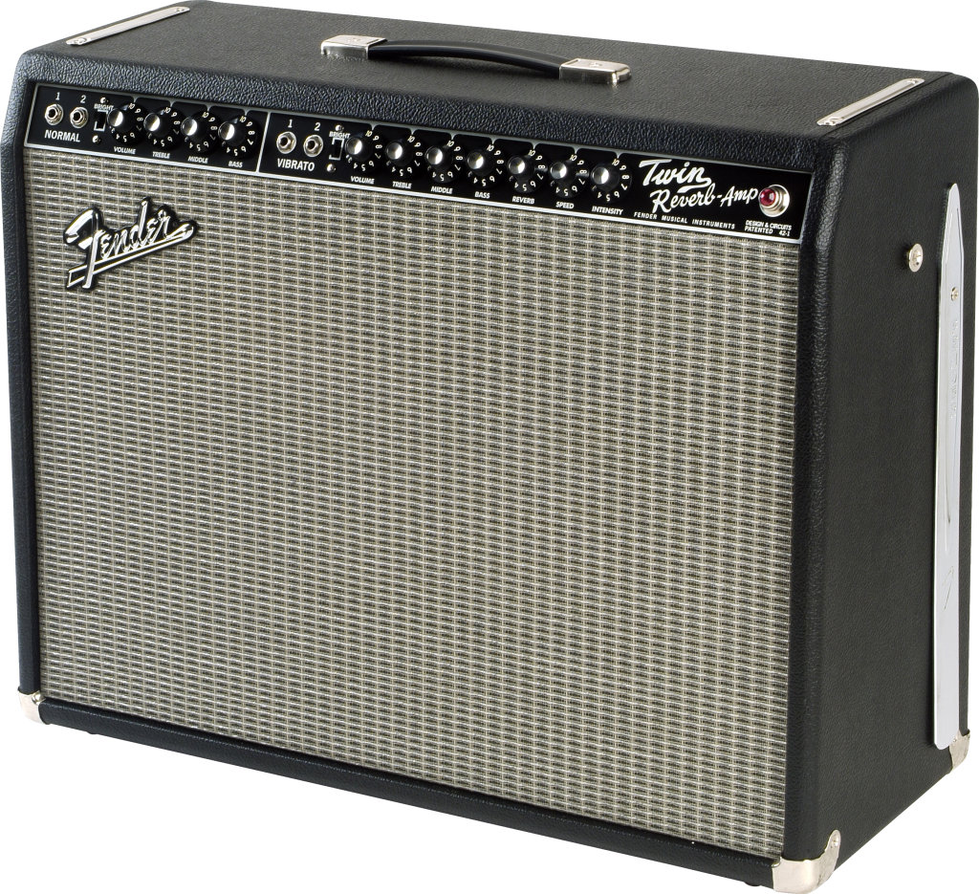
Example I:
What current will be drawn by an 85 W Fender Twin Reverb amplifier if it is connected to a 120 V outlet?
I = ?
P = V I
P = 85 W
85
=
120
I
V = 120 V
120
120
I
=
0.71
A

Slide 4
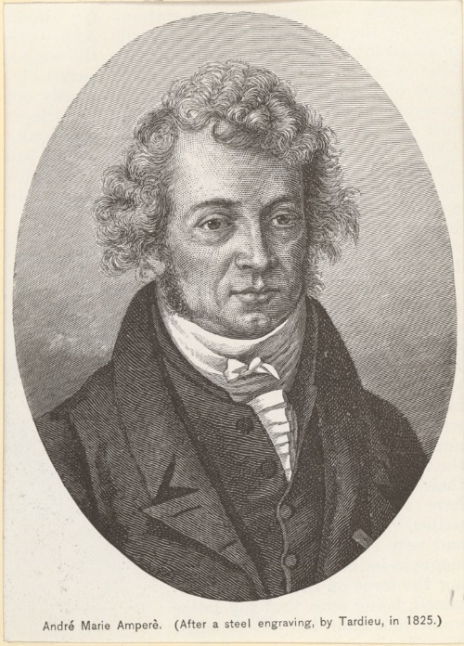
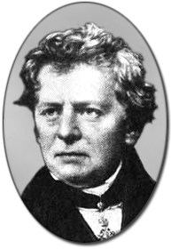
Example II:
How much power will be dissipated by a 20 Ω resistor that is connected to a potential difference of 6 V?
P = ?
P = V I
R = 20 Ω
V = 6 V
We need to know the current to find the power
Use my formula
André Ampère
Georg Ohm

Slide 5
Example II:
How much power will be dissipated by a 20 Ω resistor that is connected to a potential difference of 6 V?
P = ?
V = R I
P = V I
R = 85 Ω
V = 6 V
We need to know the current to find the power
Use my formula
André Ampère
Georg Ohm

Slide 6
Example II:
How much power will be dissipated by a 20 Ω resistor that is connected to a potential difference of 6 V?
P = ?
V = R I
P = V I
R = 20 Ω
6
=
20
I
P =
( 6 )
( 0.3 )
V = 6 V
20
20
I
=
0.3
P =
1.8
W
A

Slide 7
Energy (E):
A measure of the ability to do work.
Energy is usually measured in
joules
( J )
E = P $∆$t
Energy
time
Power
( s )
( J )
( W )
James Prescott Joule

Slide 8
Example III:
How much energy (in joules) is used by a 2 kW heater if it is operated at full power for 12 minutes?
E = ?
E = P t
P = 2 kW
2000
= ______ W
t = 12 min
720
E =
( 2000 )
( 720 )
= ______ s
E =
1 440 000
J

Slide 9
Unfortunately, energy is not just measured in joules.
Uh, oh …
When measuring electrical energy consumption for an electricity bill,
energy is measured in kilowatt-hours ( kWh )
E = P $∆$t
( kWh )
( kW )
( h )

Slide 10
Example IV:
How much energy (in kilowatt-hours) is used by a 2 kW heater if it is operated at full power for 12 minutes?
E = ?
E = P t
P = 2 kW
t = 12 min
0.2
E =
( 2 )
( 0.2 )
= ______ h
E =
0.4
kWh

Slide 11
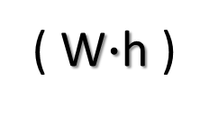
And that’s not all …
Energy can even be measured in watt-hours ( W$∙$h )
Oh, no …
E = P $∆$t
( W$∙$h )
( W )
( h )

